Slide 1
Dumpy: A Compact and Adaptive Index for Large Data Series Collections
Zeyu Wang
Fudan Univerisity
Shanghai, China
Qitong Wang
Université Paris Cité
Paris, France
Peng Wang
Fudan University
Shanghai, China
Themis Palpanas
Université Paris Cité &
French University Institute (IUF)
Paris, France
Wei Wang
Fudan University
Shanghai, China
ACM SIGMOD 2023, Seattle
paper: https://helios2.mi.parisdescartes.fr/~themisp/publications/sigmod23-dumpy.pdf
video: https://files.atypon.com/acm/99f6febc21ad6c5a979f504caf188d9a
code: https://github.com/DSM-fudan/Dumpy
Notes:
Hello, everyone. My name is Zeyu Wang. Im a PhD student at Fudan University with Peng Wang.
Today I will share with you our work on a novel data series index for scalable similarity search.

Slide 2
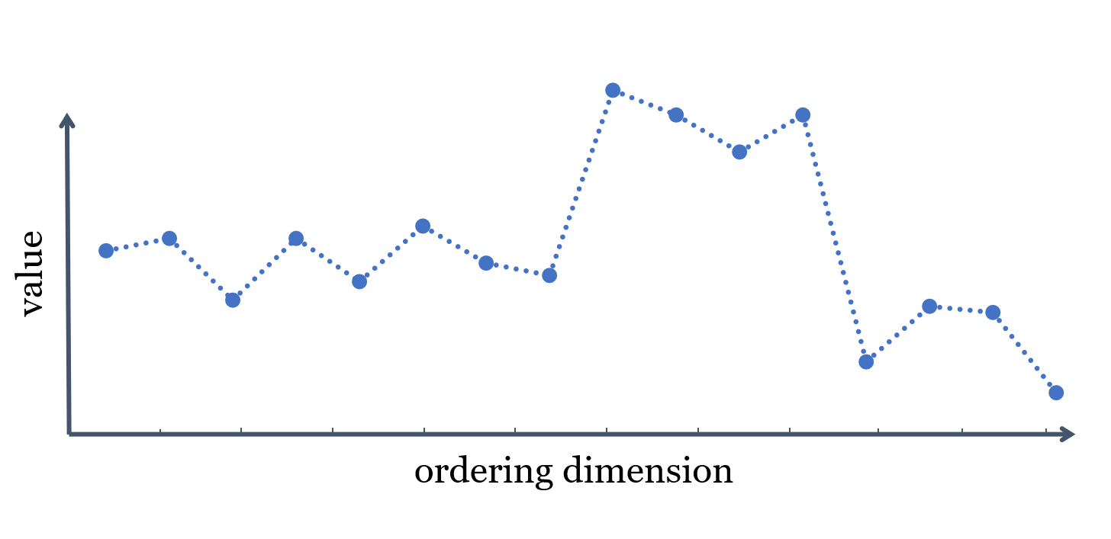
1-Data Series
Sequence of points ordered along some dimension
Notes:
A data series is a sequence of points ordered along some dimension.

Slide 3
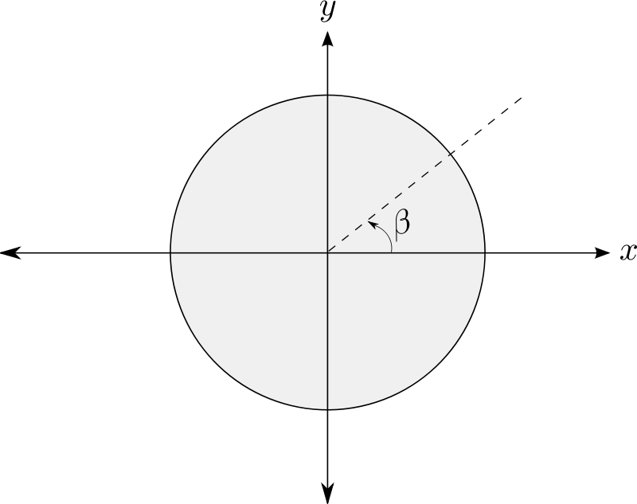
1-Data Series
Sequence of points ordered along some dimension
Angle
Time
Position
Mass
Frequency
Notes:
Typical dimensions include time, making it a time series, and angle, position, mass and frequency.

Slide 4
1-Data Series Similarity Search
Similarity Search
Query series $S_{q}$
Notes:
Data series similar search is given a query sq

Slide 5
1-Data Series Similarity Search
Similarity Search
Query series $S_{q}$
search
Series collection$S$
Notes:
to find the most similar series

Slide 6
1-Data Series Similarity Search
Similarity Search
Query series $S_{q}$
search
top-k
k-nearest
neighbor series $S_{a}$
Series collection$S$
Notes:
, or said the k-nearest neighbor series in a collection S to sq.

Slide 7
1-Data Series Similarity Search
Similarity Search
Classification
Outlier Detection
Motif Discovery
Frequent Patterns
Clustering
…
Query series $S_{q}$
search
top-k
k-nearest
neighbor series $S_{a}$
Series collection$S$
Notes:
similarity search works as the backbone to facilitate many other downstream applications, including classification, clustering, outlier detection and frequent pattern mining.

Slide 8
1-Problem Definition
Similarity search
given a series set $S$, a query series $S_{q}$ and a similarity measure $d\left(∙,∙\right)$
$d$ is commonly the Euclidean distance (ED) or Dynamic Time Warping (DTW)
find the closest series in $S$ to $s_{q}$, i.e.,
$$s_{a}=\underset{s_{i}∈S}{arg min}{d(s_{q},s_{i})}$$
Approximate similarity search
find $s_{a^{′}}$,$d(s_{q},s_{a^{′}})≈d(s_{q},s_{a})$
core requirements: Accuracy & Scalability
$$S_{q}$$
search
Exact answers sometimes unnecessary
$$S$$
top-k
$$S_{a}$$
Data Series Index
Notes:
In this paper, we provide solutions for two most common distances, euclidean distance and DTW
In real applications, exact knn answers are sometimes unnecessary
While approximate search, which finds similar series in a short latency, attracts more interest from the downstream areas.
The core requiremnts are the accurary of search results and the scalability of the method.
To satisfy these requirements, data series index is proposed.

Slide 9
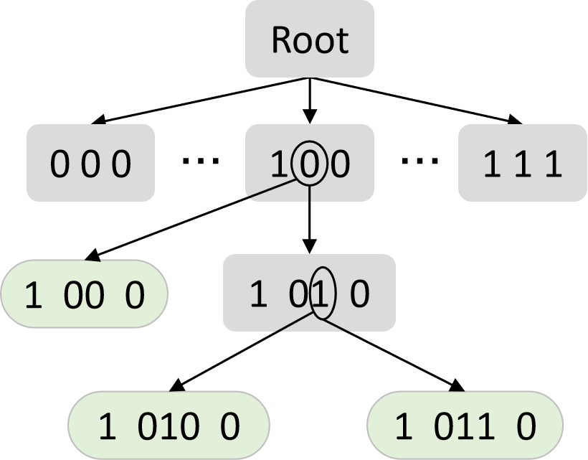
2-Limitations of Existing Solutions
Two structures of iSAX-based index
2-ary¹
Full-Ary²
Splitting Decisions
Not Accurate
Not Scalable
Problem 1: What’s the right splitting decision between these two extremes?
Problem 2: How to efficiently implement splitting?
1. Alessandro Camerra, et al. Beyond One Billion Time Series: Indexing and Mining Very Large Time Series Collections with iSAX2+. KAIS 39(1):123-151, 2014.
2. Zhang, L. et al. 2019. TARDIS: Distributed Indexing Framework for Big Time Series Data. 2019 IEEE 35th International Conference on Data Engineering (ICDE)
Notes:
State-of-the-art data series index is iSAX index family, which first summarize data series with iSAX and then build index on these summaries.
There are mainly two types of iSAX index structures.
One is two-ary, where each subtree of the root node is a binary tree, which results from making one of all possible splits given our summarization.
The other is a full-ary tree structure based on making all possible splits each time.
Since neither of them can satisfy the accuracy and scalability requirements at the same time, in this paper, we explore the design space in between.
And the second problem is how to efficiently implement splitting which finally determines the index structure and how series will be grouped in leaves. And our target is that the series in the same leaf are as similar as possible to one another.
By addressing these two problems, our solution Dumpy will improve accuracy and scalability significantly.

Slide 10
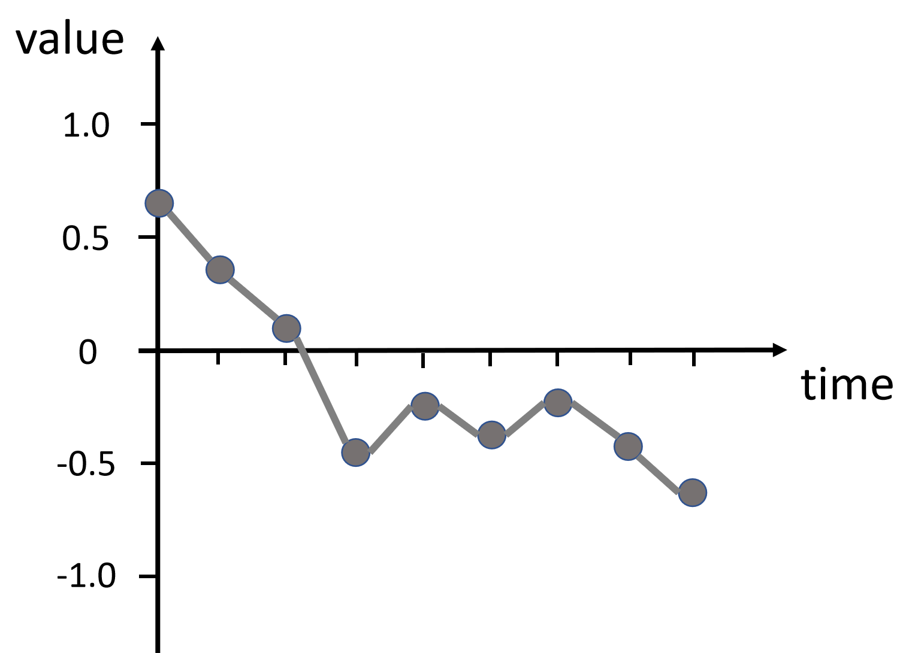
3-iSAX Index Family
Raw series
(a) raw series $s$
Notes:
Next we briefly inrtoduce the iSAX index family and analyze its problem.

Slide 11
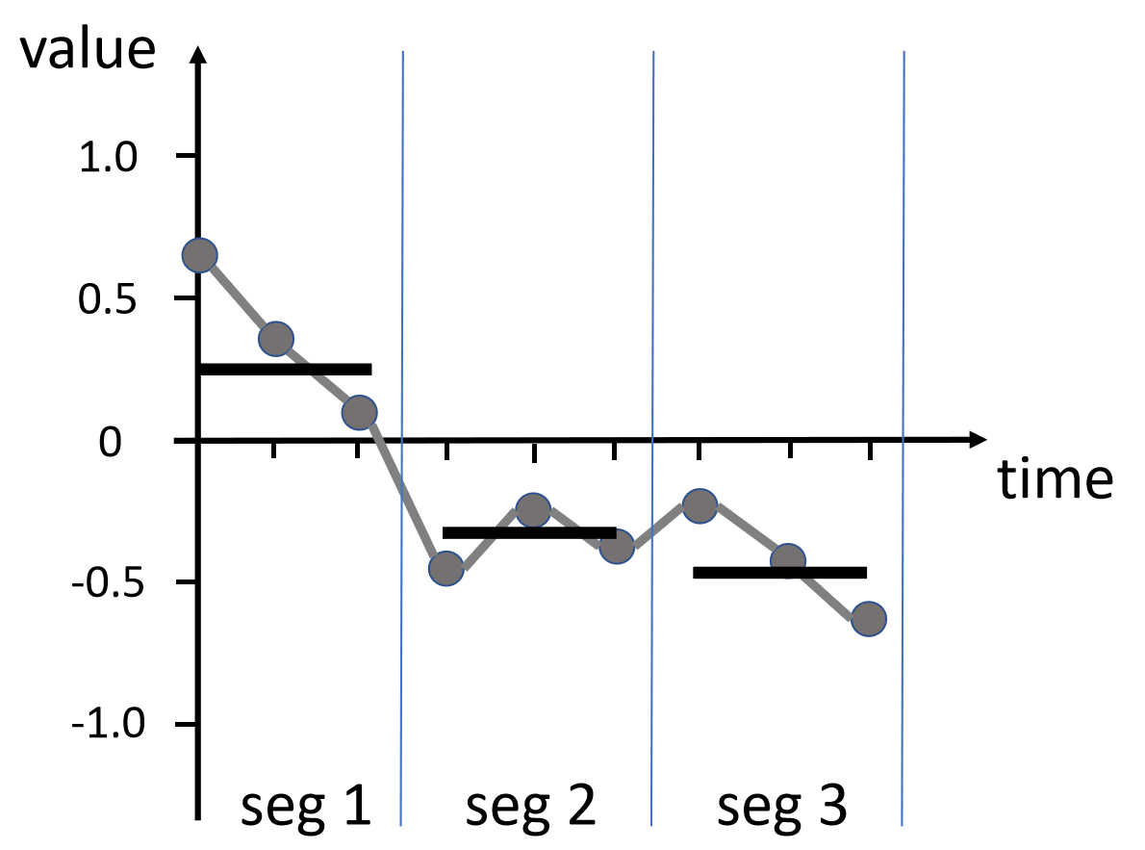
3-iSAX Index Family
Raw series $→$ PAA approximation
PAA($s$)=[0.25, -0.3, -0.55]
(a) raw series $s$
(b) PAA summarization
Notes:
To build iSAX index, a raw time series, is first translated to its PAA summariazation.
PAA splits the series into equal-length segments, and then use the mean value to represent each segment.

Slide 12
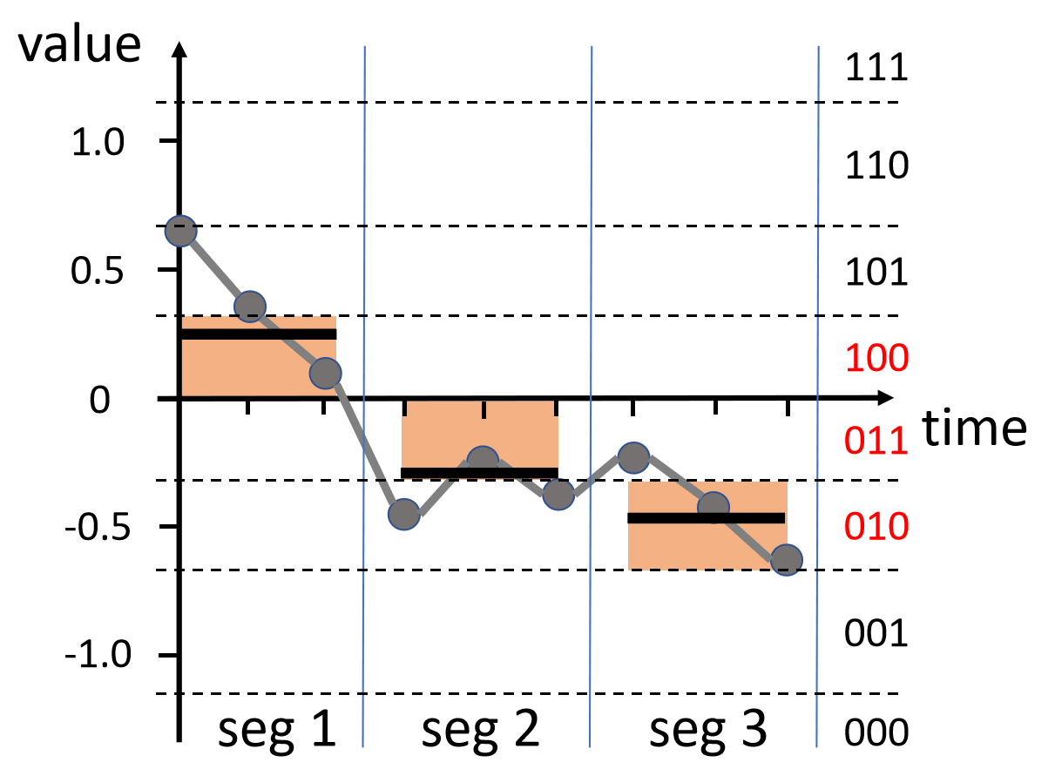
3-iSAX Index Family
Raw series $→$ PAA approximation $→$ SAX symbolization
(a) raw series
(b) PAA summarization
SAX($s$)=[
100,
011,
010,
]
(c) SAX word
breakpoints
Notes:
The mean values will then be quantized into SAX symbols based on their value ranges.
We use a group of breakpoints to partition the whole value space, with a bit-code as a symbol for each partition.
So the SAX word of a series is a list of bit-codes.

Slide 13
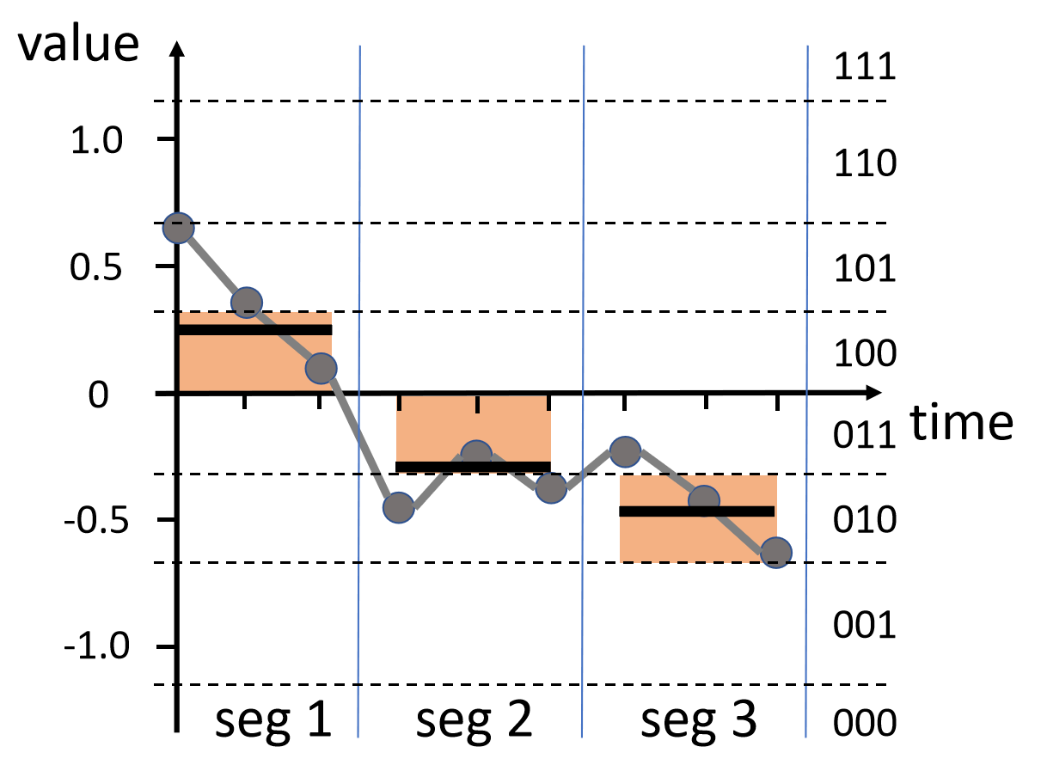
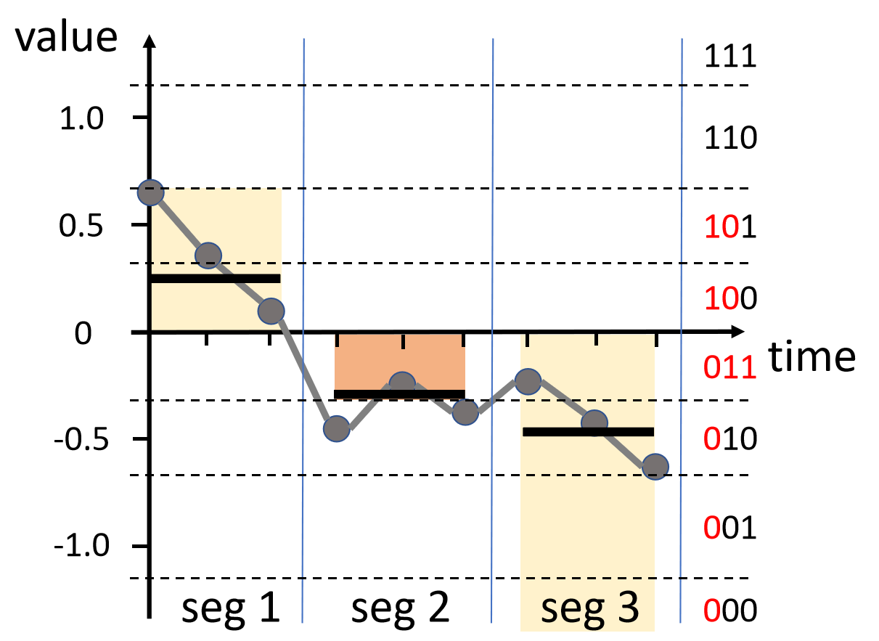
3-iSAX Index Family
Raw series $→$ PAA approximation $→$ SAX symbolization $→$ iSAX index
SAX($s$)=[100, 011, 010]
(a) raw series
(b) PAA summarization
One iSAX word of $s$
iSAX($s$)=[
10,
011,
0,
]
(c) SAX word
(d) iSAX word
Notes:
We could use different number of bits to quantize the mean value.
iSAX word is a prefix of the SAX word. Some segments are fine-grained with more bits, while others are coarse-grained with fewer bits.
In this example, the first segment has two bits covering two partitions.

Slide 14
3-iSAX Index Family
Raw series $→$ PAA approximation $→$ SAX symbolization $→$ iSAX index
SAX($s$)=[100, 011, 010]
(a) raw series
(b) PAA summarization
One iSAX word of $s$
iSAX($s$)=[
10,
011,
0,
]
(c) SAX word
(d) iSAX word
Notes:
The second segment has three bits covering one partition.

Slide 15
3-iSAX Index Family
Raw series $→$ PAA approximation $→$ SAX symbolization $→$ iSAX index
SAX($s$)=[100, 011, 010]
(a) raw series
(b) PAA summarization
One iSAX word of $s$
iSAX($s$)=[
10,
011,
0,
]
(c) SAX word
(d) iSAX word
Notes:
The third one is coarse-grained with only one bit, covering four partitions.

Slide 16
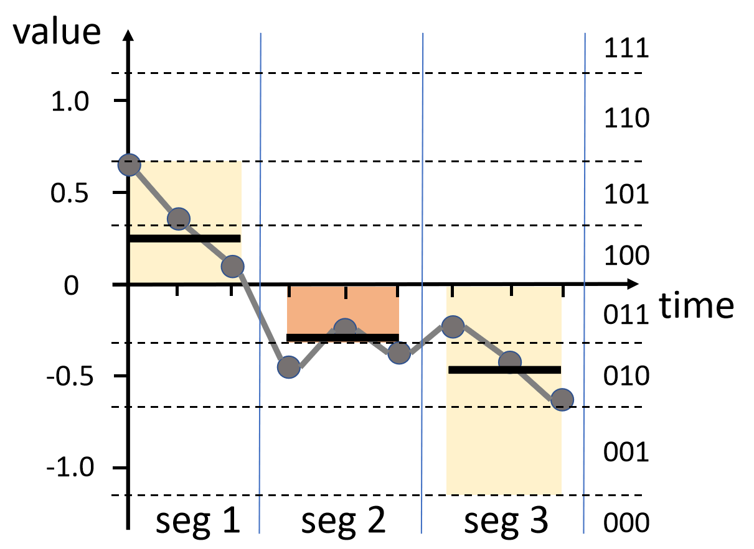
3-iSAX Index Family
Raw series $→$ PAA approximation $→$ SAX symbolization $→$ iSAX index
Root
0 0 0
...
1 0 0
...
1 1 1
extend one bit in seg 1
(a) raw series
(b) PAA summarization
11 0 0
10 0 0
Internal node
10 00 0
10 01 0
Leaf node
extend one bit in seg 2
iSAX index
(c) SAX word
(d) iSAX word
iSAX($s$)=[10, 011, 0]
Notes:
Based on iSAX summarization, iSAX index is designed as a top-down tree structure.
The series inside each node has a common iSAX word.
We can split the over-sized node by extending one bit along some segment.
It actually splits the SAX space hierarchically.

Slide 17
4-Proximity Problem of 2-ary iSAX Index
Root
0 0 0
...
1 0 0
...
1 1 1
1 00 0
1 01 0
1 010 0
1 011 0
Notes:
Now we introduce the proximity problem of two-ary iSAX index. That is, the series in the same node is not simlar enough.
Consider this leaf node of this iSAX index.

Slide 18
4-Proximity Problem of 2-ary iSAX Index
Root
0 0 0
...
1 0 0
...
1 1 1
1 00 0
1 01 0
1 010 0
1 011 0
high-granularity
(split many times)
Notes:
the second segment is split three times and has a high granularity.

Slide 19
4-Proximity Problem of 2-ary iSAX Index
Root
0 0 0
...
1 0 0
...
1 1 1
1 00 0
1 01 0
1 010 0
1 011 0
low-granularity
(no split or few times)
Notes:
while the other 2 segments are hardly chosen and have a low-granularity

Slide 20
4-Proximity Problem of 2-ary iSAX Index
low degree of distinction
seg 1
seg 2
seg 3
SAX
Root
value
111
0 0 0
...
1 0 0
...
1 1 1
1.0
110
0.5
101
1 00 0
1 01 0
100
skewed split
0
time
011
1 010 0
1 011 0
-0.5
010
-1.0
001
000
high degree of distinction
Notes:
In the SAX space, the low-granulairty segment covers a large value range and is thus hard to distinct different series.
The high-ranularity, on the contrary, has a high degree of distintion.

Slide 21
4-Proximity Problem of 2-ary iSAX Index
seg 1
seg 2
seg 3
value
Root
a
1.0
b
0 0 0
...
1 0 0
...
1 1 1
c
0.5
1 00 0
1 01 0
0
time
skewed split
-0.5
1 010 0
1 011 0
-1.0
b and c are very close
c excluded in this node for seg 2
Notes:
Such a skewed split results that the series inside a node are not similar.
Consider these three series, two grey series, b and c are very close but c is excluded from this node for the slight difference in segment 2.

Slide 22
4-Proximity Problem of 2-ary iSAX Index
seg 1
seg 2
seg 3
value
Root
a
1.0
b
0 0 0
...
1 0 0
...
1 1 1
c
0.5
1 00 0
1 01 0
0
time
skewed split
-0.5
1 010 0
1 011 0
-1.0
a is far from b and c
a is included in this node together with b
Notes:
On the other, the blue series a, is far from the other 2 series, but mixed in this node.
The large differene in segment 1 and 3 are ignored due to the low distinction in these two segments.

Slide 23
4-Proximity Problem of 2-ary iSAX Index
seg 1
seg 2
seg 3
value
Root
a
1.0
b
0 0 0
...
1 0 0
...
1 1 1
c
0.5
1 00 0
1 01 0
0
time
skewed split
b and c are very close
-0.5
1 010 0
1 011 0
-1.0
a is far from b and c
Reason:
over-focus on similarity on seg 2, but final distance equally contributed by all 3 segments
Notes:
The reason behind is that this node over-focuse on the similarity on segment 2. But the final distance is eaqually contributed by all 3 segments.
This leads to a low proximity of series inside nodes

Slide 24
4-Proximity Problem of 2-ary iSAX Index
Skewed Split
Even Split
seg 1
seg 2
seg 3
seg 1
seg 2
seg 3
value
value
1.0
a
a
b
1.0
b
0.5
c
c
0.5
0
time
0
time
-0.5
-0.5
-1.0
-1.0
c excluded in this node for seg 2
b and c are very close
a and b are grouped together in this node
c is excluded
Notes:
If it’s turned to an even split where each segment has a similar granularity, the result will be corret.

Slide 25
5-Compactness Problem of full-ary iSAX Index
Root
0 0 0
...
1 0 0
...
1 1 1
00 00 00
...
01 01 01
10 00 00
...
11 01 01
10 10 10
...
...
001 001 001
100 000 000
...
101 000 000
...
101 001 001
100 100 100
...
Notes:
The full-ary index is proposed based on this heuristic.

Slide 26
5-Compactness Problem of full-ary iSAX Index
Root
0 0 0
...
1 0 0
...
1 1 1
00 00 00
...
01 01 01
10 00 00
...
11 01 01
10 10 10
...
...
001 001 001
100 000 000
...
101 000 000
...
101 001 001
100 100 100
...
$2^{w}$ ^{new nodes in each split}
$w$^{: number of segments}
more random disk accesses in index building and querying!
Notes:
It extends all segments when spliting and surely generates even split.
However, it generates too many nodes and leads to excessive random disk accesses in index building and querying.

Slide 27
6-Proximity-Compactness Trade-off
2-ary
Full-Ary
Splitting Decisions
Compactness
Proximity
with proximity problem:
skewed split
with compactness problem:
low fill factor
Dumpy dynamically strikes the right balance in this trade-off!
Notes:
We observe that between these two extremes, there is a design trade-off about the fanout limiting the overall performance of iSAX index.
And it is impossible to determine a fixed fanout or structure for all cases.
Therefore, Dumpy chooses to dynamically decide the fanout and the split strategy to strike the right balance in this trade-off.

Slide 28
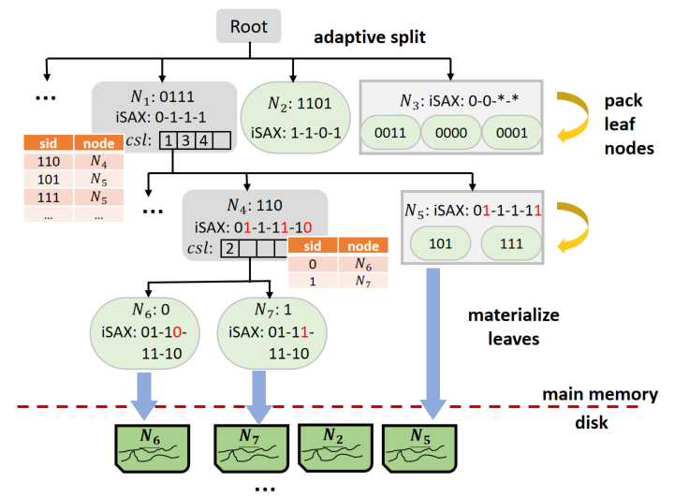
7-Dumpy’s Adaptive Split Strategy
Multi-ary Index Structure
2 ≤ fanout ≤ $2^{w}$
$w$^{: number of segments}
internal node
leaf node
$csl(N)$: list of segments to be split of node $N$
routing table
leaf pack
$sid$: concatenation of newly-extended bits compared with parent node
Notes:
We now elaborate our solution, Dumpy’s adaptive spit strategy.
Dumpy doesn’t determine the fanout or how to split at the beginning, but at the time when we`ve collected enough information and are ready to split.
The fanout of a node can be any number between two and two to the power of w.

Slide 29
7-Dumpy’s Adaptive Split Strategy
Multi-ary Index Structure
2 ≤ fanout ≤ $2^{w}$
$w$^{: number of segments}
internal node
leaf node
$csl(N)$: list of segments to be split of node $N$
routing table
leaf pack
$sid$: concatenation of newly-extended bits compared with parent node
Notes:
Formally, the target of our split algorithm is to determine a list of segments, denoted by csl, and we split the node along the segments in csl.
And sid is the concatenation of newly-extened bits in splitting. It`s to identify a child node among its siblings.

Slide 30
7-Dumpy’s Adaptive Split Strategy
Decide fanout and segments to split on-the-fly
$$csl(N)$$
$csl(N)$ can be any non-empty combination
of all $w$ segments.
Totally,$2^{w}−1$possible ways to split.
Which one is the optimal?
internal node
leaf node
routing table
leaf pack
Notes:
Note that csl of a node can be any non-empty combination of all w segments. And so there are totally expenenal number ways to split.
We need to first determine which is the best, and then search for it efficiently.

Slide 31
7-Dumpy’s Adaptive Split Strategy
Decide fanout and segments to split on-the-fly
$$csl(N)$$
$csl(N)$ can be any non-empty combination
of all $w$ segments.
Totally,$2^{w}−1$possible ways to split.
Which one is the optimal?
Proximity-Compactness Trade-off
objective function:
$$\max_{csl(N)}{e^{\sqrt{\frac{1}{|csl(N)|}Var({X’}_{N})}}+α∗e^{−(1+o)σ_{F}}}$$
internal node
leaf node
routing table
leaf pack
weight factor
Proximity term
Compactness term
Notes:
We use an objective fucntion to score the splits, which is a weighted sum of proximity term and compactness term.
The plan having the max score is viewed as the optimal.

Slide 32
7-Dumpy’s Adaptive Split Strategy
Innovation 1: Adaptive split strategy
$$\max_{csl(N)}{e^{\sqrt{\frac{1}{|csl(N)|}Var({χ’}_{N})}}+α∗e^{−(1+o)σ_{F}}}$$
Proximity term
avg. distance to the centroid
next breakpoint
next breakpoint
seg 4
contribute little to the whole distance:
weak distinguishment
seg 2
seg 1
seg 3
previous breakpoint
previous breakpoint
PAA points projected on the segments of the plan
$μ$^{: centroid of these SAX points}
Notes:
The proximity term is defined by the variance of SAX points inside the node.
Here we project the SAX points on the segments of a split plan.
The variance is defined as the average distance between these SAX points and their centroids.
We prefer a large variance to obtain better distinguishment.
If the variance is small, it means that these segments contribute little to the whole distance and hence the ability to distinguish different series is weak.

Slide 33
7-Dumpy’s Adaptive Split Strategy
Innovation 1: Adaptive split strategy
$$\max_{csl(N)}{e^{\sqrt{\frac{1}{|csl(N)|}Var({χ’}_{N})}}+α∗e^{−(1+o)σ_{F}}}$$
Compactness term
stdev of fill factors of child nodes
next breakpoint
next breakpoint
seg 2
seg 4
only few candidates when visiting this node
seg 1
seg 3
previous breakpoint
previous breakpoint
PAA points projected on the segments of the plan
Notes:
The compactness term is the standard deviation of fill factors of child nodes.
Dumpy expects balanced child nodes and penalize overflowed child nodes.
The imbalanced split will generate small nodes and when we visit them only a few candidates can be accessed.

Slide 34
8-Fast search for optimal split
1. pre-compute variance
ONE time scan for all split plans
Notes:
Next, we introduce 3 techniques to speedup searching for the optimal plan.
We first prove that the variance of SAX points can be pre-computed by linearly summing the variances in all segments.
It can be computed once for all split plans.

Slide 35
8-Fast search for optimal split
1. pre-compute variance
ONE time scan for all split plans
2. restrict the search space
skip the split plan whose fanout is
too large or small
Notes:
The second one is to restrict the search space by skipping the plans with too large or too small fanout

Slide 36
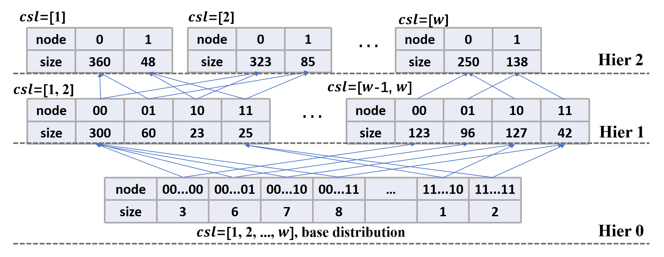
8-Fast search for optimal split
1. pre-compute variance
ONE time scan for all split plans
2. restrict the search space
skip the split plan whose fanout is
too large or small
3. hierarchically compute sizes of child nodes
recursive computing:
CONSTANT complexity for most split plans
Notes:
The third one is that the child node sizes can be computed hierarchically from other splits.
It results in a constant complexity for evaluating the objective function of most candidate plans
<8min

Slide 37
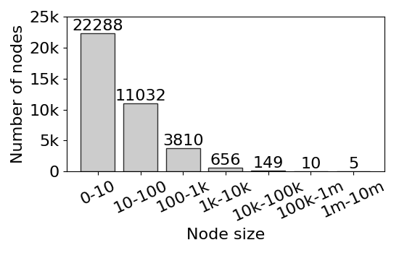
9-Data Skewness of iSAX Index
Most leaves are very small!
Node size distribution on the 1st layer of iSAX ($w$=16)
$w$^{: number of segments}
Notes:
Another problem of iSAX index family is data skewness.
This figure shows the distribution of node sizes in the first layer of iSAX index.
We can see the sizes of most leaves are below 100, which is very small on disk.
It will incur many random I/Os in index building and querying.

Slide 38
10-Dumpy’s Leaf Node Packing
Group small similar leaf nodes into a pack
Input: small leaf nodes under the same parent (siblings)
Output: A group of leaf packs within the size constraints
internal node
leaf node
routing table
leaf pack
Notes:
In this case, Dumpy groups small and similar leaves into leaf packs to mitigate the data skewness and reduce random disk accesses.
The size of leaf pack is also within the leaf capacity to avoid further split.

Slide 39
10-Dumpy’s Leaf Node Packing
Group small close leaf nodes into a pack
$$How to measure?$$
Input: small leaf nodes under the same parent (siblings)
Output: A group of leaf packs within the size constraints
internal node
leaf node
routing table
leaf pack
Notes:
The problem is that which leaves are simiar enough to be packed together?

Slide 40
10-Dumpy’s Leaf Node Packing
Input: Small leaf nodes under the same parent (siblings)
Output: A group of leaf node packs within the size constriant
only ONE
different symbol
0111
packing
$N_{1}$: iSAX: 0-1-*-1
leaf node:
sid
0111
0101
0101
leaf pack:
$$N_{1}$$
sid
sid
Notes:
We take an example to illustrate this problem.
these two sibling leaves have only one different symbol. So the series inside are basically similar.
We use one star to mask the different segment.

Slide 41
10-Dumpy’s Leaf Node Packing
Input: Small leaf nodes under the same parent (siblings)
Output: A group of leaf node packs within the size constriant
only ONE
different symbol
0111
packing
$N_{1}$: iSAX: 0-1-*-1
leaf node:
sid
0111
0101
0101
leaf pack:
$$N_{1}$$
sid
sid
packing
3 different symbols
0111
$N_{2}$: iSAX: *-*-*-1
1001
0111
0101
Notes:
On the contrary, these two leaves have three different symbols, and if packed together, the leaf pack have three stars and in the SAX space, it covers a large area and has a low level of distinction.

Slide 42
10-Dumpy’s Leaf Node Packing
Input: Small leaf nodes under the same parent (siblings)
Output: A group of leaf node packs within the size constriant
Core idea: limit the number of different symbols (#(*)) in the leaf pack.
only ONE
different symbol
0111
packing
$N_{1}$: iSAX: 0-1-*-1
leaf node:
sid
wildcard character
0101
0111
0101
leaf pack:
$$N_{1}$$
sid
sid
packing
3 different symbols
0111
$N_{2}$: iSAX: *-*-*-1
1001
0111
0101
Notes:
So our core idea is to minimize the number of different symbols in the leaf packs

Slide 43
10-Dumpy’s Leaf Node Packing
Greedily select the best pack or create a new one
01*01
1*01*
01101
Pack 1
Pack 2
10010
01101
01001
Pack 3
11010
01101
10011
Notes:
Here we take an example to describe our algorithm.
Consider there have been three packs with some leaves inside. These leaves are the input of algorithm.

Slide 44
10-Dumpy’s Leaf Node Packing
Greedily select the best pack or create a new one
find a pack for this leaf
11101
01*01
1*01*
01101
Pack 1
Pack 2
10010
01101
01001
Pack 3
11010
01101
10011
Notes:
Now we want to find a pack for this leaf.

Slide 45
10-Dumpy’s Leaf Node Packing
Greedily select the best pack or create a new one
find a pack for this leaf
11101
create a
new pack
01*01
1*01*
01101
#(*) <= 3
Pack 1
Pack 2
10010
01101
01001
Pack 3
11010
01101
10011
Notes:
There are 4 options. Put it into existing packs or create a new one for that.

Slide 46
10-Dumpy’s Leaf Node Packing
Greedily select the best pack or create a new one
find a pack for this leaf
11101
create a
new pack
01*01
1*01*
01101
#(*) <= 3
Pack 1
Pack 2
10010
01101
01001
Pack 3
11010
01101
10011
01*01
*1*01
add 1 *
Notes:
If we select the first pack, this leaf will introduce one more star.

Slide 47
10-Dumpy’s Leaf Node Packing
Greedily select the best pack or create a new one
find a pack for this leaf
11101
create a
new pack
01*01
1*01*
01101
#(*) <= 3
Pack 1
Pack 2
10010
01101
01001
Pack 3
11010
01101
10011
01*01
*1*01
1*01*
1****
add 1 *
4 * in total
Notes:
If it’s the second pack, then it will be 4 stars in total. It violates the constraints.

Slide 48
10-Dumpy’s Leaf Node Packing
Greedily select the best pack or create a new one
find a pack for this leaf
11101
create a
new pack
01*01
1*01*
01101
#(*) <= 3
Pack 1
Pack 2
10010
01101
01001
Pack 3
11010
01101
10011
01*01
*1*01
1*01*
1****
01101
*1101
add 1 *
4 * in total
add 1 *
Notes:
The third pack is similar to pack 1, but with smaller size.

Slide 49
10-Dumpy’s Leaf Node Packing
Greedily select the best pack or create a new one
find a pack for this leaf
11101
create a
new pack
01*01
1*01*
01101
#(*) <= 3
Pack 1
Pack 2
10010
01101
01001
Pack 3
11010
01101
10011
01*01
*1*01
1*01*
1****
01101
*1101
11101
add 1 *
4 * in total
add 1 *
only 1 leaf
Notes:
Unless all existing packs violate the constraint, we don’t create a new pack for the reason of compactness.

Slide 50
10-Dumpy’s Leaf Node Packing
Greedily select the best pack or create a new one
find a pack for this leaf
11101
create a
new pack
01*01
1*01*
01101
#(*) <= 3
Pack 1
Pack 2
10010
01101
01001
Pack 3
11010
01101
10011
01*01
*1*01
1*01*
1****
01101
*1101
11101
add 1 *
4 * in total
add 1 *
only 1 leaf
Notes:
We greedily select the pack with the least number of newly-introduced stars.
The tie is broken by size.

Slide 51
10-Dumpy’s Leaf Node Packing
Greedily select the best pack or create a new one
create a
new pack
01*01
1*01*
*1101
#(*) <= 3
Pack 1
Pack 2
10010
01101
01001
Pack 3
11010
11101
01101
10011
01*01
*1*01
1*01*
1****
01101
*1101
11101
add 1 *
4 * in total
add 1 *
only 1 leaf
Notes:
So we finally select the third pack.
When we iterate over all input leaves, the packing algorithm terminates.

Slide 52
11-Dumpy-Fuzzy
An example of Boundary Issue:
seg 1
seg 2
seg 3
111
hard boundary
110
a and b are very close
but lie on different nodes
101
100
a: 110, 110, 100
011
010
b: 110, 101, 100
001
000
Notes:
Next I`ll introduce Dumpy-Fuzzy.
As a space-partition-based method, Dumpy also meets the boundary issue.
In this example, these two series are very close but lie on different nodes for their slight different near the boundary in seg 2.
And so we might miss one of them when querying.

Slide 53
11-Dumpy-Fuzzy
An example of Boundary Issue:
seg 1
seg 2
seg 3
111
fuzzy boundary (a range)
110
duplicate close series into neighboring nodes
101
100
a: 110, 110, 100
011
010
b:
001
000
Notes:
To solve this problem, we turn the static hard boundary into a fuzzy boundary, actually a value range.
and duplicate the series in this range.

Slide 54
11-Dumpy-Fuzzy
An example of Boundary Issue:
seg 1
seg 2
seg 3
111
fuzzy boundary (a range)
110
duplicate close series into neighboring nodes
101
100
a: 110, 110, 100
011
b:
110, 110, 100
110, 101, 100
belongs to 2 leaves
010
001
000
Notes:
In this example, the blue series b, is duplicated into the node of a.
In this way, Dumpy-Fuzzy mitigates the boundary issue and improves search accuracy.

Slide 55
12-Experimental Setup
Datasets
synthetic: Rand
real: DNA, ECG, Deep
Comparison methods
iSAX2+ (2-ary iSAX-based)
TARDIS (full-ary iSAX-based)
DSTree (EAPCA-based)
Dataset | Length | Dataset size
RandomWalk | 256 | 100m (100GB)
DNA | 1024 | 26m (113GB)
ECG | 320 | 97m (117 GB)
Deep1B | 96 | 100m (38GB)
Notes:
< 11’
Now we evaluate Dumpy in experiments.
We use one synthetic and three real datasets from various domains in 100 GigaBytes.
We compare Dumpy with two iSAX-based indexes and DSTree as the SOTA data series indexes.

Slide 56
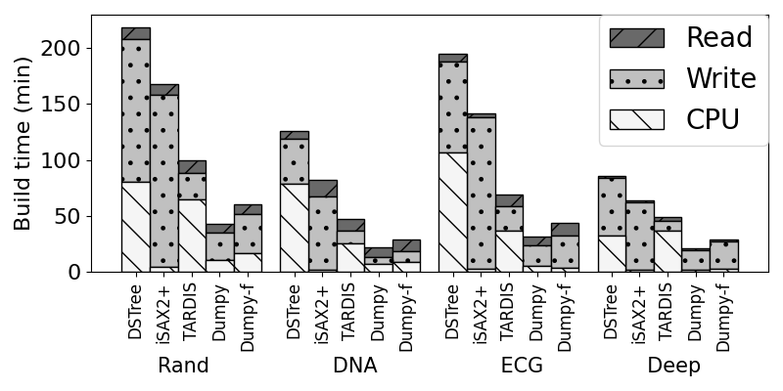
13-Scalability on Index Building
Notes:
We first compare the building time across four datasets

Slide 57
13-Scalability on Index Building
fastest index building, 2.5x~5.3x faster than SOTA
Most compact structure
Notes:
Dumpy’s building times are all within half an hour, showing the best compactness of index structure and fastest index building

Slide 58
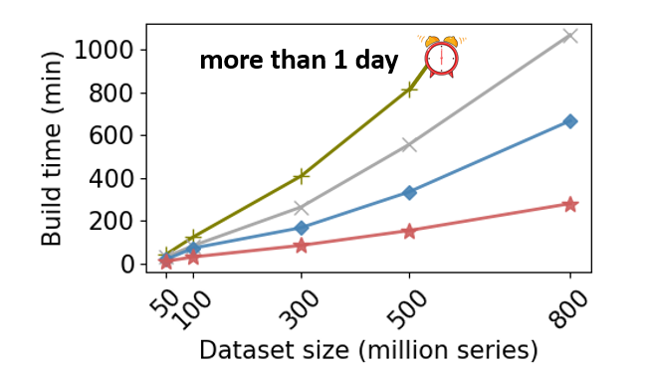
13-Scalability on Index Building
fastest index building, 2.5x faster than TARDIS (SOTA)
Most compact structure
linear scalability ($R^{2}$> 0.99)
Notes:
On TB-level dataset, Dumpy shows linear scalability.

Slide 59
13-Scalability on Index Building
4x
2.6x
fastest index building, 2.5x faster than TARDIS (SOTA)
Most compact structure
linear scalability
up to 4x faster than SOTA for 800GB data
Notes:
achieving up to 4 faster than SOTA for 800 GB data.

Slide 60
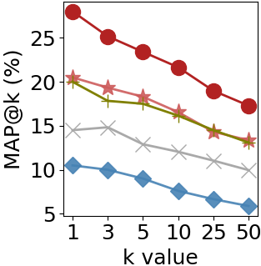
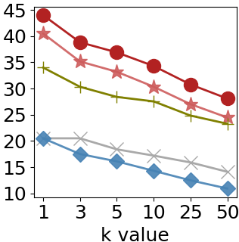
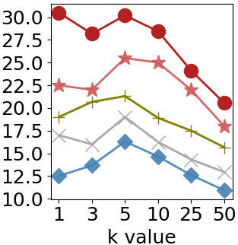
14-Search Accuracy (search one node)
Dumpy-f
(a) Rand
(b) DNA
(c) ECG
Notes:
We evaluate the proximity of nodes by testing the precision of search results when visiting one leaf node.

Slide 61
14-Search Accuracy (search one node)
Dumpy-f
(a) Rand
(b) DNA
(c) ECG
highest MAP (Mean Average Precision)
Best proximity of nodes
11%~84% higher MAP than SOTA
Notes:
The result shows Dumpy has the best proximity.

Slide 62
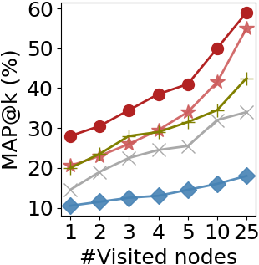
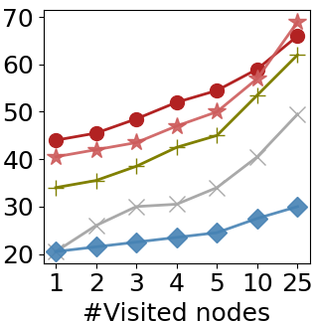
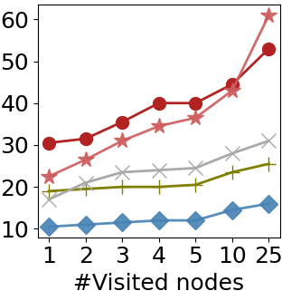
14-Search Accuracy (search more nodes)
Dumpy-f
(a) Rand
(b) DNA
(c) ECG
16%~125% higher MAP than SOTA
Notes:
When searching for more nodes, Dumpy achieves ...

Slide 63
14-Search Accuracy (search one node)
Dumpy-f
1.4x
1.2x
2.3x
(a) Rand
(b) DNA
(c) ECG
16%~125% higher MAP than SOTA
60% more accurate than DSTree when visiting 25 nodes (~100ms query time)

Slide 64
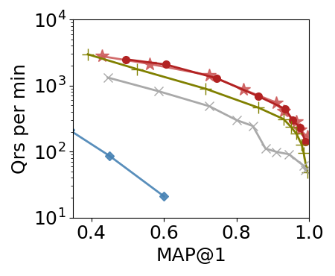
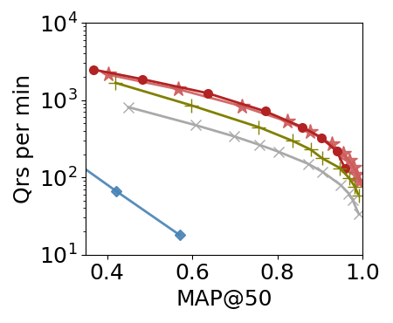
15-Pruning-based (approximate) search
Dumpy-f
top right is better
Notes:
Next we show the performance comparison on claissical pruning-based search

Slide 65
15-Pruning-based (approximate) search
Dumpy-f
top right is better
Best throughput under the same accuracy
67% higher throughput than DSTree under 80% MAP
Notes:
Dumpy also shows the ...

Slide 66
16-Conclusions
Identify the inherent proximity-compactness trade-off in the structural design of SOTA iSAX-index family
Propose Dumpy, a compact and adaptive multi-ary data series index striking the right balance of this trade-off
faster index-building and better scalability
more accurate and efficient simialrity searh
Devise Dumpy-Fuzzy that further improves search accuracy by mitigating the hard boundary issue
Notes:
< 14.5 min

Slide 67
Thanks!
Dumpy: A Compact and Adaptive Index for Large Data Series Collections
Zeyu Wang, Qitong Wang, Peng Wang, Themis Palpanas and Wei Wang
ACM SIGMOD 2023, Seattle
paper: https://helios2.mi.parisdescartes.fr/~themisp/publications/sigmod23-dumpy.pdf
video: https://files.atypon.com/acm/99f6febc21ad6c5a979f504caf188d9a
code: https://github.com/DSM-fudan/Dumpy

