Slide 1
Elpis: Graph-Based Similarity Search for Scalable Data Science
Ilias Azizi, Karima Echihabi, Themis Palpanas
August 30th, 2023
Notes:
Hello everyone my name is ilias azizi, i am very please to present you today our work entitled elpis a graph based

Slide 2
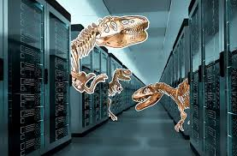
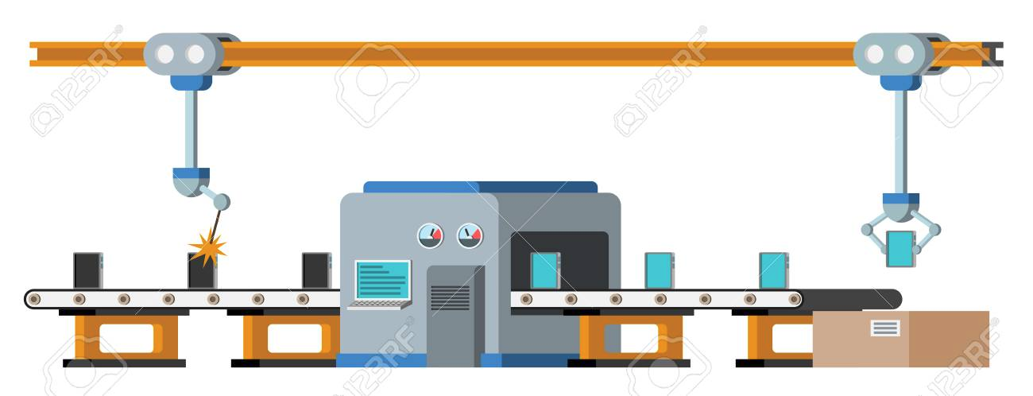
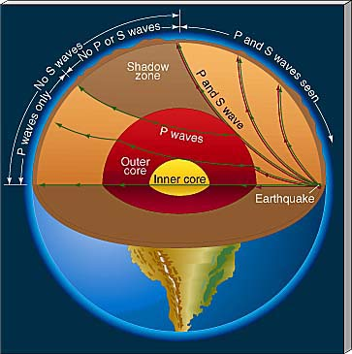
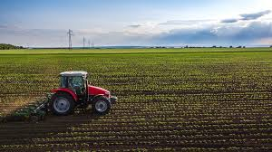
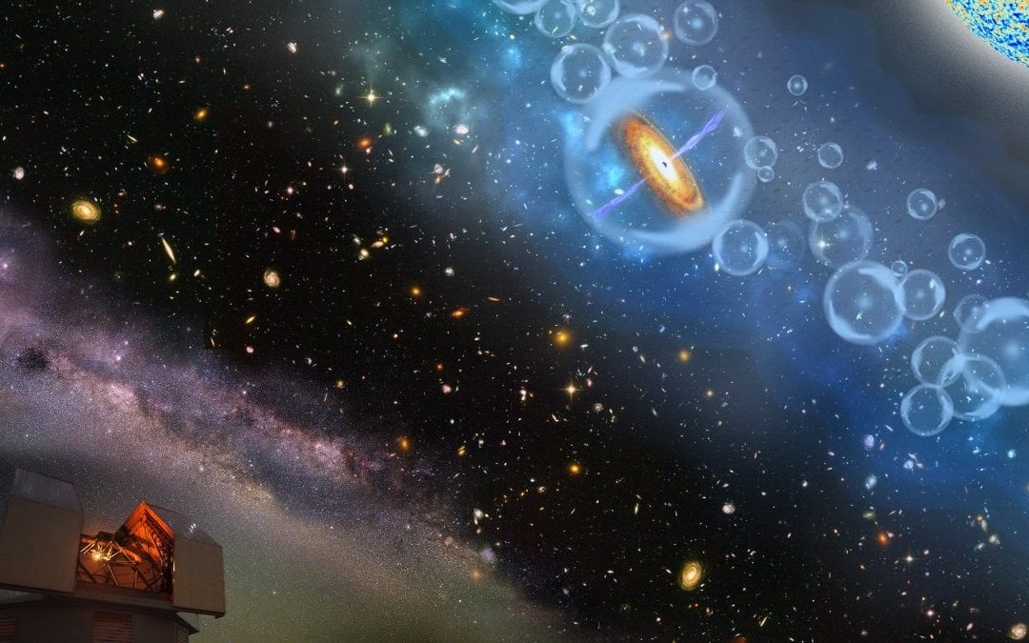
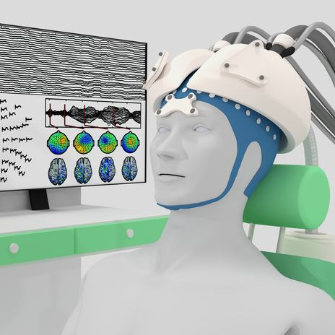
High-Dimensional Data
High-dimensional data is everywhere
Finance
Paleontology
Manufacturing
Aviation
Agriculture
Astronomy
Criminology
Seismology
Neuroscience
Medicine
Biology
IOT
Notes:
Data science applications operate over high-dimensional data collections which are omni present in verous domain, from finance agriculture , to medicine and internet of things.
the most popular high dimensional data are nowadays typically encoded as dense vectors like data series or embeddings

Slide 3
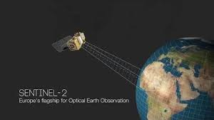
High-Dimensional Data
High-dimensional collections are massive
≈ 500 ZB per year
≈ 130 TB
> 40 PB per day
1 PB = 1 thousand TB
1 ZB = 1 billion TB
> 5 TB per day
> 500 TB per day
Notes:
and they come in massive collections which are in multiple terrabites, which makes processing and analysing these vectors a real bottleneck in many applications

Slide 4
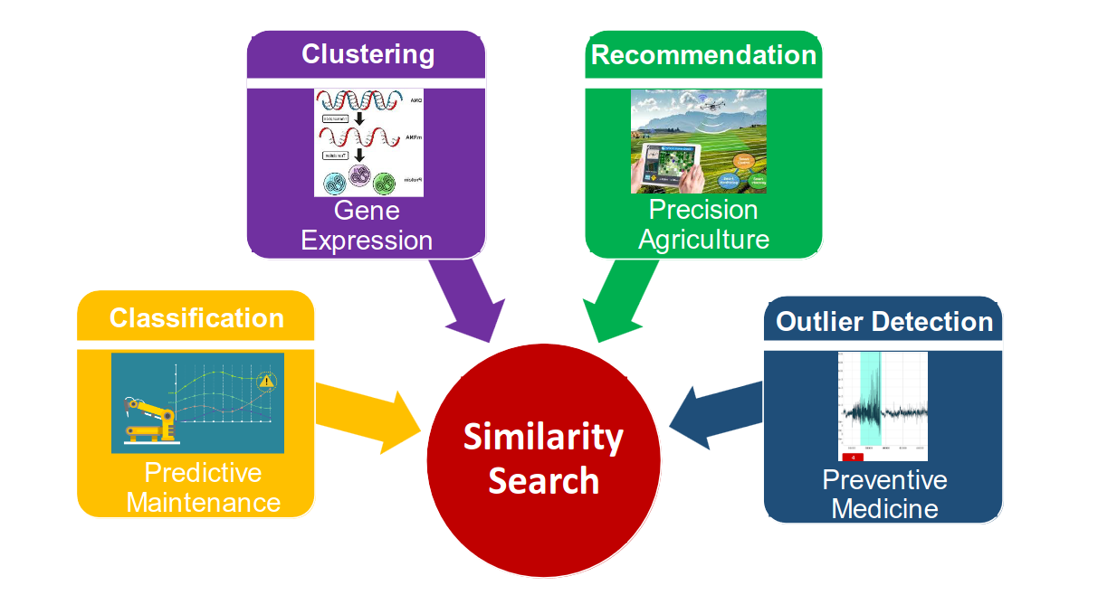
Similarity Search in High-Dimensional Data
Data cleaning
Data integration
Notes:
Similarity search comes into the picture as fundamental building block for a number of critical data science tasks, including preprocessing tasks such as data cleaning and intergration,

Slide 5
Similarity Search Problem
Given: a set S of n distinct points in d-dimensional space R^{d} under some norm ∥.∥
Goal: for any query Q ∈R^{d}, return the set of K points in S that are closest to Q under ∥.∥
Notes:
The problem involves preprocessing a dataset S of d dimension using a distance function, to find most similar elment of the dataset to given query Q.
There exist different flavors of nn search, including exact and approximate search, in this presentation we will mainly focus on the ng approximate search, and this is a real problem for many real world applications such as vector search engine

Slide 6
Similarity Search Approaches
Tree-Based
Notes:
Fast search requires a pre process and indexing of data. And the main three classes of data structure index for approximate nearest neighbor search are
the tree based indexing which partition the data into hierarchical sub-spaces using a tree data structure, where similar data points are gathered within the same leaves.

Slide 7
Similarity Search Approaches
Tree-Based
Hash-Based
Notes:
Hash-based methods partition points into buckets using hash functions, and nearby points are likely to be mapped to the same bucket.

Slide 8
Similarity Search Approaches
Tree-Based
Hash-Based
Graph-Based
Notes:
graph based approache structures the dataset into a prox- imity graph, where data points are represented as connected vertices and the connections are exploited to guide the query into similar vertices

Slide 9
Similarity Search Approaches
ANN Family | Advantage | Disadvantage
Tree-Based (data series) | Low index construction time Can support different flavors of search | Low search performance on hard query workloads
Hash-Based | Support theoretical guarantees on query efficiency and accuracy | High index construction time High footprint Low search performance (efficiency, accuracy)
Graph-Based | Excellent empirical query accuracy and efficiency | High Index construction time High footprint No guarantees on search quality
Notes:
Each similarity search method family has pros and cons. Tree-based techniques excel at index building; However, they can fail on challenging queries. Hash-based methods promise theoretical efficiency and accuracy which nonetheless doesn't translate into a good real-world recall. Graph-based approaches shine empirically, but constructing graph on large dataset is costly.

Slide 10
Similarity Search Approaches
ANN Family | Advantage | Disadvantage
Tree-Based (data series) | Low index construction time Can support different flavors of search | Low search performance on hard query workloads
Hash-Based | Support theoretical guarantees on query efficiency and accuracy | High index construction time High footprint Low search performance (efficiency, accuracy)
Graph-Based | Excellent empirical query accuracy and efficiency | High Index construction time High footprint No guarantees on search quality
Notes:
thus in this work, we exploit ideas of two familiers, grph and tree based indices, to adress indexing scalability challenges of graph indexing family whiloe mainting the excelelnt empirical query performance

Slide 11
Key idea
The scalability of graph-based approximate similarity search can be improved by splitting a large dataset into multiple clusters, constructing a proximity graph for each cluster
Q1 What is the best clustering strategy?
Q2 What is the optimal data structure to use within each cluster?
Q3 What is the best strategy for pruning clusters during search?
Q4 What is the best strategy for pruning vertices inside each cluster?
Notes:
we achieves this by adapting a dc approach, where we split a large dataset into multiple…
through this work, we adressed the following rq

Slide 12
Contributions
A comprehensive survey of the state-of-the-art graph-based ANNS algorithms.
A thorough experimental evaluation of representative techniques on large datasets.
Elpis, an in-memory ng-approximate similarity search method for SIMD, multi-core, multi-socket architectures :
Elpis delivers a 10NN query response in under 3 milliseconds for a dataset of 1 billion vectors with a high recall of 0.99.
Elpis builds index 8x faster than the best competitors, using 40% less memory
Elpis achieves recall of 0.99, up to 2x faster than state-of-the-art methods, answers 1-NN queries up to one order of magnitude faster
Notes:
we contribute in our work with a ,
and we proposed elpis

Slide 13
Preliminaries
Notes:
before we see how elpis approach works, we should understand how the existing graph based anns methods works

Slide 14
Proximity Graph
Graph in which two vertices are connected by an edge if and only if
the vertices satisfy particular geometric requirements
Q
Notes:
all graph structures designed for similarity search are what we call proximity graph, in which two ver…
And the “Proximity” here means spatial distance., for retrieving nn of given a query node, the most common and efficient way to search a proximity graph is using beam search.

Slide 15
Beam Search
Beam search is a heuristic search algorithm that explores a graph by expanding the most optimistic node in a limited set of size L
BeamSearch(G, Q, entry_node, K, L)
Predefined nodes.
Searching in lightweight pre-built indices constructed using a small dataset sample.
Random node(s).
Notes:
beam search is a..
and require 4 parameters, the graph and the query,, the starting node or entry point from which the graph search should start, the number of nn to retrieve and the beam width. We can select the entry point(s) through many methods: either 1.(i.e centroid or random), 2. 3. selected at each search.

Slide 16
Beam Search
BeamSearch(G, Q, entry_node = 1, K, L = 6)
1
Initialize the set of candidate nearest neighbors C_NN with entry_ node, and the set of visited nodes with empty set 𝑽← ∅
7
9
22
4
5
23
2
3
19
20
16
13
Q
10
6
1
8
21
18
14
L (Beam width) = 6
11
15
12
17
dist(1,Q)
C_NN
Notes:
let assume that node 1 is the entry points, the beam search start first by init…
and set of visited node to empty

Slide 17
Beam Search
BeamSearch(G, Q, entry_node = 1, K, L = 6)
2.1 Select the closest element P from C_NN\𝑽
2
While(C_NN\𝑽≠∅)
7
9
22
4
5
23
2
3
19
20
16
13
Q
10
6
1
8
21
18
14
L (Beam width) = 6
11
15
12
17
dist(1,Q)
C_NN
C_NN
Notes:
and while there is a candidate in the candidate nn set not yet visited.
we select the closest element to the query from the set candnn

Slide 18
Beam Search
BeamSearch(G, Q, entry_node = 1, K, L = 6)
2.2 Add P neighbors to C_NN
2
While(C_NN\𝑽≠∅)
7
9
22
4
5
23
2
3
19
20
16
13
Q
10
6
1
dist(16,Q)
18
8
21
14
L (Beam width) = 6
15
dist(10,Q)
11
12
17
dist(15,Q)
dist(1,Q)
C_NN
Notes:
we add its neighbors to the candidate set

Slide 19
Beam Search
BeamSearch(G, Q, entry_node = 1, K, L = 6)
2.3 Add P to the set of visited candidate 𝑽
2
While(C_NN\𝑽≠∅)
7
9
22
4
5
23
2
3
19
20
16
13
Q
10
6
1
dist(16,Q)
18
8
21
14
L (Beam width) = 6
15
dist(10,Q)
11
12
17
dist(15,Q)
dist(1,Q)
C_NN
Notes:
and add the current node into visited node set, we will mark the visited node in gray color

Slide 20
Beam Search
BeamSearch(G, Q, entry_node = 1, K, L = 6)
2
While(C_NN\𝑽≠∅)
2.4 If |C_NN| > L:
update C_NN to retain closest L points to Q
7
9
22
4
5
23
2
3
19
20
16
13
Q
10
6
1
dist(16,Q)
18
8
21
14
L (Beam width) = 6
15
dist(10,Q)
11
12
17
dist(15,Q)
dist(1,Q)
C_NN
Notes:
we limit then the number of candidates the set of candidate nn to L by retaining the closest one to the query.

Slide 21
Beam Search
BeamSearch(G, Q, entry_node = 1, K, L = 6)
2.1 Select the closest element P from C_NN\𝑽
2
While(C_NN\𝑽≠∅)
7
9
22
4
5
23
2
3
19
20
16
13
Q
10
6
1
dist(16,Q)
18
8
21
14
L (Beam width) = 6
15
dist(10,Q)
11
12
17
dist(15,Q)
dist(1,Q)
C_NN
Notes:
we repeat the process again until all nodes in candidate nearest neighbors set are visited

Slide 22
Beam Search
BeamSearch(G, Q, entry_node = 1, K, L = 6)
2
While(C_NN\𝑽≠∅)
2.2 Add P neighbors to C_NN
2.3 Add P to the set of visited candidate 𝑽
7
9
22
4
5
23
2
dist(5,Q)
3
19
20
16
13
Q
dist(13,Q)
10
6
1
8
dist(16,Q)
21
18
14
L (Beam width) = 6
15
dist(10,Q)
11
12
17
dist(15,Q)
dist(1,Q)
C_NN
Notes:
we repeat the process again until all nodes in candidate nearest neighbors set are visited

Slide 23
Beam Search
BeamSearch(G, Q, entry_node = 1, K, L = 6)
2
While(C_NN\𝑽≠∅)
2.4 If |C_NN| > L:
update C_NN to retain closest L points to Q
7
9
22
4
5
23
2
dist(5,Q)
3
19
20
16
13
Q
dist(13,Q)
10
6
1
8
dist(16,Q)
21
18
14
L (Beam width) = 6
15
dist(10,Q)
11
12
17
dist(15,Q)
dist(1,Q)
C_NN
Notes:
we repeat the process again until all nodes in candidate nearest neighbors set are visited

Slide 24
Beam Search
BeamSearch(G, Q, entry_node = 1, K, L = 6)
2
While(C_NN\𝑽≠∅)
2.2 Add P neighbors to C_NN
2.3 Add P to the set of visited candidate 𝑽
dist(18,Q)
dist(19,Q)
7
9
4
dist(2,Q)
22
5
2
23
dist(5,Q)
3
19
20
16
dist(13,Q)
13
Q
10
6
1
dist(16,Q)
18
8
21
14
L (Beam width) = 6
15
dist(10,Q)
11
12
17
dist(15,Q)
dist(1,Q)
C_NN
Notes:
we repeat the process again until all nodes in candidate nearest neighbors set are visited

Slide 25
Beam Search
BeamSearch(G, Q, entry_node = 1, K, L = 6)
2
While(C_NN\𝑽≠∅)
2.4 If |C_NN| > L:
update C_NN to retain closest L points to Q
dist(18,Q)
dist(19,Q)
7
9
4
dist(2,Q)
22
5
2
23
dist(5,Q)
3
19
20
16
dist(13,Q)
13
Q
10
6
1
dist(16,Q)
18
8
21
14
L (Beam width) = 6
15
dist(10,Q)
11
12
17
dist(15,Q)
dist(1,Q)
C_NN
Notes:
and when the size of cand set exceed the beamwith l, we prune nodes from candidate set who are far from the query

Slide 26
Beam Search
BeamSearch(G, Q, entry_node = 1, K, L = 6)
2
While(C_NN\𝑽≠∅)
2.4 If |C_NN| > L:
update C_NN to retain closest L points to Q
7
9
22
4
5
23
2
dist(18,Q)
3
19
20
16
13
Q
dist(19,Q)
10
6
1
8
dist(2,Q)
21
18
14
L (Beam width) = 6
15
dist(13,Q)
11
12
17
dist(16,Q)
dist(1,Q)
C_NN
Notes:
we repeat the process again until all nodes in candidate nearest neighbors set are visited

Slide 27
Beam Search
BeamSearch(G, Q, entry_node = 1, K, L = 6)
2
While(C_NN\𝑽≠∅)
7
9
22
4
5
23
C_NN\𝑽==∅
2
dist(4,Q)
3
19
20
16
13
Q
dist(14,Q)
10
6
1
8
dist(8,Q)
21
18
14
L (Beam width) = 6
15
dist(20,Q)
11
12
17
dist(19,Q)
dist(18,Q)
C_NN
Notes:
and when all candidate nn in our set are visited nodes, we stop the search

Slide 28
Beam Search
BeamSearch(G, Q, entry_node = 1, K, L = 6)
3
Return K closest neighbors from C_NN
7
9
22
4
5
23
2
dist(4,Q)
3
19
20
16
13
Q
dist(14,Q)
10
6
1
8
dist(8,Q)
21
18
14
L (Beam width) = 6
15
dist(20,Q)
11
12
17
dist(19,Q)
dist(18,Q)
C_NN
Notes:
and return k closest candidate nearest neighbors in our
the majority of state of the art method followz the same paradigme to retrieve the nn answers,
what generally differentiate a method from another is the construction approach

Slide 29
Roadmap of Graph-Based ANNS Algorithms
NSW
(Y.Malkov et al.)
2011
Kgraph
(W.Dong et al.)
2011
Delaunay-Based Graph
KNN-Based Graph
IEH
(Z.Jin et al.)
2014
RNG-Based Graph
DC-Based Graph
HNSW
(Y.Malkov et al.)
2016
DPG
(W. Li et al.)
2016
EFANNA
(C.Fu et al.)
2016
Time
SPTAG
(H. Wang et al.)
2018
NSG
(C.Fu et al.)
2018
HCNNG
(J. Munoz et al.)
2019
VAMANA
(Suhas et al.)
2019
NSSG
(C.Fu et al.)
2019
ELPIS
(I. Azizi et al.)
2023
ELPIS
(I. Azizi et al.)
2023
Notes:
that can be categorized into four distinct classes. arrows between the state of the art methods signify both their interdependence and developmental evolution.
1 - Delaunay-based graphs emerge through incremental insertion, while knng-based graphs are refined through neighbor propagation of an initial random or knn graph.
Both delaunay and knng methods proved inefficient due to high number of distance calculations.
2 - A new trend emerged: rng-based graphs, aiming for sparsity and efficient search while maintaining accuracy. These methods optimize initial graphs through pruning triangular connections in the graph
3 - A third category is divide and conquer methods, which divide the data into multiple sets, after which multiple graphs are built and in most of case, merged into one graph. except for Elpis where we maintain multiple graphs

Slide 30
ELPIS
Notes:
so let’s now cover the indexing and query processing of elpis framework

Slide 31
Elpis Structure
-0.25, 0.54
0.45, 1.24
-0.25, 0.54
0.45, 1.24
Root
|____________|
ELPIS combines tree and graph structures for efficient in-memory ng-approximate vector similarity search.
-0.25, 0.10
0.45, 0.93
-0.22, 0.54
0.48, 1.24
I1
L4
|____________|
|____________|
-0.25, -0.15
0.45, 0.71
0.11, 0.31
1.23, 1.32
-0.31, -0.11
0.44, 0.54
L1
I2
|____________|
|________|_______|
-0.31, -0.27
0.49, 0.54
L3
0.26, 0.31
1.23, 1.26
0.11, 0.28
1.28, 1.32
L2
-0.28, -0.11
0.44, 0.53
|________|_______|
|________|_______|
Notes:
Elpis combines

Slide 32
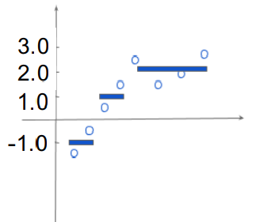
Elpis Index Building
-0.25, 0.54
0.45, 1.24
Root
|____________|
EAPCA data series summarization
-0.25, 0.10
0.45, 0.93
-0.22, 0.54
0.48, 1.24
I1
L4
|____________|
|____________|
V = {-1.5,-0.5,0.5,1.5,2.5,1.5,2,2.6}
-0.25, -0.15
0.45, 0.71
I2
L1
0.11, 0.31
1.23, 1.32
-0.31, -0.11
0.44, 0.54
|____________|
|________|_______|
L2
L3
0.26, 0.31
1.23, 1.26
-0.31, -0.27
0.49, 0.54
0.11, 0.28
1.28, 1.32
-0.28, -0.11
0.44, 0.53
|________|_______|
|________|_______|
EAPCA(V) = {[-1,0.5],[1,0.5],[2.15,0.44]}
Notes:
the index construction process is as following, we first build Hercules EAPCA tree structure .
EAPCA is a summarization techniqe where each segment is represented by its mean and std
each node of the tree haas a EAPCA representation(which summarize all associated vectors: with maximum and minimum mean and std of each segment:), and all the leaves have a max leaf size.

Slide 33
Elpis Index Building
X_{i}
-0.25, 0.54
0.45, 1.24
-0.25, 0.54
0.45, 1.24
-0.25, 0.54
0.45, 1.24
HSplitSynopsis
SG(Root) = SG(I1) = SG(L4)
Z(Root) derived from Z(I1) and Z(L4)
Root
|____________|
-0.25, 0.10
0.45, 0.93
-0.22, 0.54
0.48, 1.24
-0.25, 0.10
0.45, 0.93
-0.25, 0.10
0.45, 0.93
L4
VSplitSynopsis
SG(I1) = SG(L1) ≠ SG(I2)
Z(Root) derived from Z(L1) and series of I2
I1
|____________|
|____________|
-0.25, -0.15
0.45, 0.71
I2
L1
0.11, 0.31
1.23, 1.32
-0.31, -0.11
0.44, 0.54
|____________|
|________|_______|
S^{L4}={ x₁^{L4},x₂^{L4},..,x_{n}^{L4}}
L2
L3
S^{L1}={ x₁^{L1},x₂^{L1},..,x_{n}^{L1}}
0.26, 0.31
1.23, 1.26
-0.31, -0.27
0.49, 0.54
0.11, 0.28
1.28, 1.32
-0.28, -0.11
0.44, 0.53
|________|_______|
|________|_______|
Dataset S = S^{L1}+S^{L2}+S^{L3}+S^{L4}
S^{L2}={ x₁^{L2},x₂^{L2},..,x_{n}^{L2}}
S^{L3}={ x₁^{L3},x₂^{L3},..,x_{n}^{L3}}
Notes:
during the construction , we incrementally insert data point and guide it through nodes until it reached it associated leaf in a DFS manner
when a leaf reaches the max ls, we choose a policy to split the data into two children leaves” a
horizontal splitting where we split data based on mean value of a selected segments,
or the split of a segment into two segments with vertical splitting which results in additional dimension, the Eapca tree select the best splitting strategy that will maximize the separation between the new children leaves
3 - when all the data point are inserted into the tree. then elpis build an HNSW graph for each leaf

Slide 34
Graph Leaf: Hierarchical Navigable Small World
HNSW stack multiple NSW into a mutli-resolution layers of approximate NSW graphs to solve connectivity problem
Notes:
HNSW stacks multiple approximate nearest neighbor graphs into hierarchical layers, where the bottom layer contains all data points corresponding nodes, and the number of nodes descreases while ascending through layers

Slide 35
Graph Leaf: Hierarchical Navigable Small World
HNSW stack multiple NSW into a mutli-resolution layers of approximate NSW graphs to solve connectivity problem
HNSW's hierarchical layer edges act as long-range connections, aiding distance calculation pruning in searches
Notes:
this design is inspired from skipped list structure, and allows hnsw to reach query’s region in base layer before starting the beam search from a close starting node

Slide 36
Elpis Index Building
-0.25, 0.54
0.45, 1.24
-0.25, 0.54
0.45, 1.24
Root
|____________|
Elpis concurrently constructs graphs using nw1 workers, with each worker building Hierarchical NSW graph within each leaf in parallel using nw2 workers.
-0.25, 0.10
0.45, 0.93
-0.22, 0.54
0.48, 1.24
I1
L4
|____________|
|____________|
-0.25, -0.15
0.45, 0.71
I2
L1
0.11, 0.31
1.23, 1.32
-0.31, -0.11
0.44, 0.54
|____________|
|________|_______|
L2
L3
0.26, 0.31
1.23, 1.26
-0.31, -0.27
0.49, 0.54
0.11, 0.28
1.28, 1.32
-0.28, -0.11
0.44, 0.53
|________|_______|
|________|_______|
Notes:
and to efficiently construct all graphs, elpis concu…

Slide 37
Elpis Query Search
Q
-0.25, 0.54
0.45, 1.24
-0.25, 0.54
0.45, 1.24
Root
|____________|
Elpis query search initiates with a beam search on the approximate graph leaf
-0.25, 0.10
0.45, 0.93
-0.22, 0.54
0.48, 1.24
I1
L4
|____________|
|____________|
-0.25, -0.15
0.45, 0.71
I2
L1
0.11, 0.31
1.23, 1.32
-0.31, -0.11
0.44, 0.54
|____________|
|________|_______|
L2
L3
0.26, 0.31
1.23, 1.26
-0.31, -0.27
0.49, 0.54
0.11, 0.28
1.28, 1.32
-0.28, -0.11
0.44, 0.53
|________|_______|
|________|_______|
dist(8,Q)
dist(20,Q)
L (Beam width)
dist(19,Q)
dist(18,Q)
C_NN_{L2}
Notes:
for answering a query :
1 in the first …determined through a Depth-First Search traversal on the Hercules index tree, and retrieve k approximate answers

Slide 38
Elpis Query Search
Q
-0.25, 0.54
0.45, 1.24
-0.25, 0.54
0.45, 1.24
Root
|____________|
Elpis selects nprobes - 1 potential leaves through Breadth-First Search using K-bsf answers and EAPCA lower bounding distances.
-0.25, 0.10
0.45, 0.93
-0.22, 0.54
0.48, 1.24
I1
L4
|____________|
|____________|
-0.25, -0.15
0.45, 0.71
I2
L1
0.11, 0.31
1.23, 1.32
-0.31, -0.11
0.44, 0.54
|____________|
|________|_______|
L2
L3
0.26, 0.31
1.23, 1.26
-0.31, -0.27
0.49, 0.54
0.11, 0.28
1.28, 1.32
-0.28, -0.11
0.44, 0.53
|________|_______|
|________|_______|
dist(8,Q)
dist(20,Q)
L (Beam width)
dist(19,Q)
dist(18,Q)
C_NN_{L2}
Notes:
2- then

Slide 39
Elpis Query Search
Q
-0.25, 0.54
0.45, 1.24
-0.25, 0.54
0.45, 1.24
Root
|____________|
Elpis warms-up with the approximate results nw (≤ nprobes-1) priority queues for nw workers to conduct concurrent searches on nprobes - 1 graphs.
-0.25, 0.10
0.45, 0.93
-0.22, 0.54
0.48, 1.24
I1
L4
|____________|
|____________|
-0.25, -0.15
0.45, 0.71
I2
L1
0.11, 0.31
1.23, 1.32
-0.31, -0.11
0.44, 0.54
|____________|
|________|_______|
L2
L3
0.26, 0.31
1.23, 1.26
-0.31, -0.27
0.49, 0.54
0.11, 0.28
1.28, 1.32
-0.28, -0.11
0.44, 0.53
|________|_______|
|________|_______|
dist(8,Q)
dist(20,Q)
dist(19,Q)
dist(8,Q)
dist(18,Q)
dist(20,Q)
C_NN_{L1}
dist(19,Q)
dist(18,Q)
C_NN_{L3}
dist(8,Q)
dist(20,Q)
L (Beam width)
dist(19,Q)
dist(18,Q)
C_NN_{L2}
Notes:
f
.copying the candidate nn set of approximate search before starting the search on nprobes - 1 graphs helps elpis to prune and guide the search process inside each graph efficienty, enabling efficient exploration of potential candidates and narrowing down the search space in the other graphs.
4 finally ..

Slide 40
Elpis Query Search
Q
-0.25, 0.54
0.45, 1.24
-0.25, 0.54
0.45, 1.24
Root
|____________|
ELPIS aggregates answers from all priority queues, returning 𝑘 smallest Euclidean distance answers.
-0.25, 0.10
0.45, 0.93
-0.22, 0.54
0.48, 1.24
I1
L4
|____________|
|____________|
-0.25, -0.15
0.45, 0.71
I2
L1
0.11, 0.31
1.23, 1.32
-0.31, -0.11
0.44, 0.54
|____________|
|________|_______|
L2
L3
0.26, 0.31
1.23, 1.26
-0.31, -0.27
0.49, 0.54
0.11, 0.28
1.28, 1.32
-0.28, -0.11
0.44, 0.53
|________|_______|
|________|_______|
dist(46,Q)
dist(3,Q)
dist(11,Q)
dist(24,Q)
dist(4,Q)
dist(33,Q)
C_NN_{L1}
dist(7,Q)
dist(39,Q)
dist(39,Q)
dist(19,Q)
∑
dist(11,Q)
C_NN_{L3}
dist(18,Q)
dist(8,Q)
C_NN
dist(20,Q)
dist(19,Q)
dist(18,Q)
C_NN_{L2}
Notes:
finally, elpis aggregate results of all searches and

Slide 41
Results
Notes:
to validate Elpis performance, we compared our method with the state-of-the-art graph based methods,

Slide 42
Experimental Setup
Baselines :
HNSW
NSG
VAMANA
HCNNG
DPG
EFANNA
KGRAPH
Notes:
for that we selected best methods for graph based ng approximate similarity search in litterature

Slide 43
Experimental Setup
Datasets :
Sift1B: 1 billion vectors of 128 dimensions representing the Sift image feature descriptors.
Deep1B: 1 billion vectors of 96 dimensions extracted from the last layers of a convolutional neural network.
Sald: 200 million neuroscience MRI data series of size 128 .
Seismic: 100 million data series of size 256 representing earthquake recordings at seismic stations worldwide.
RandPowi: contains vectors of 256 dimensions generated randomly following power law distribution using power law exponent i.
Notes:
and run experiments on various large real world dataset up to 1b vectors and 256 dimension, and clustered random dataset

Slide 44
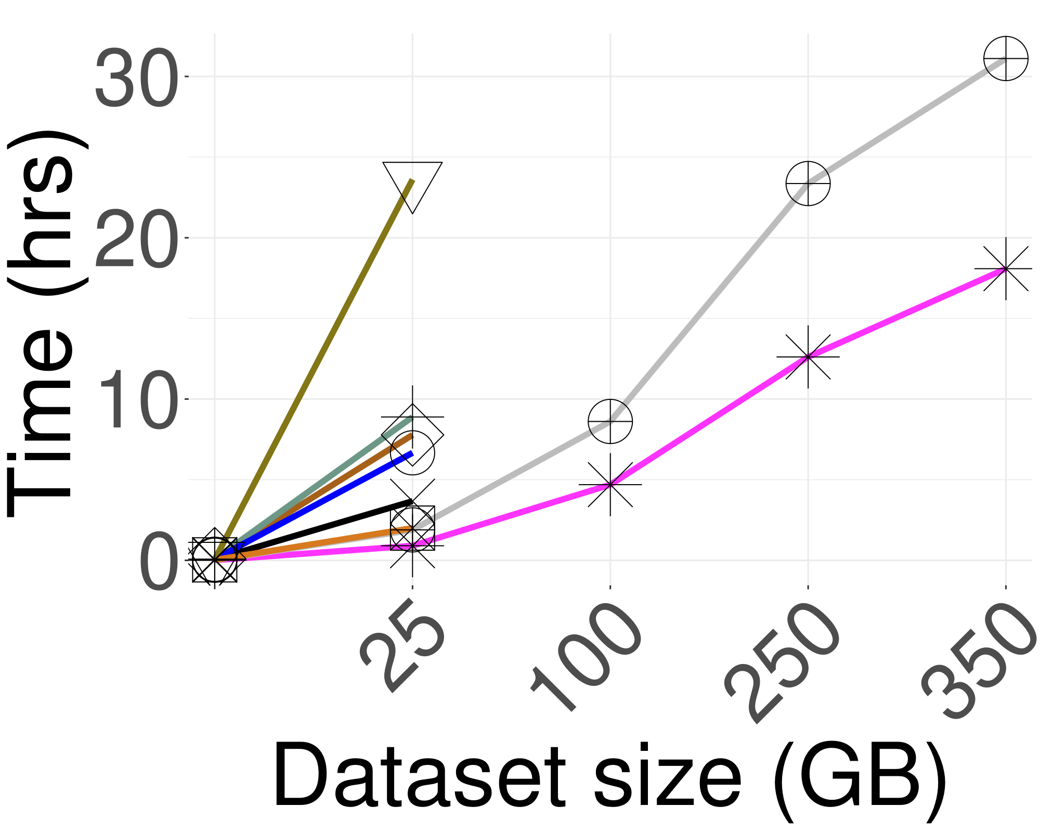
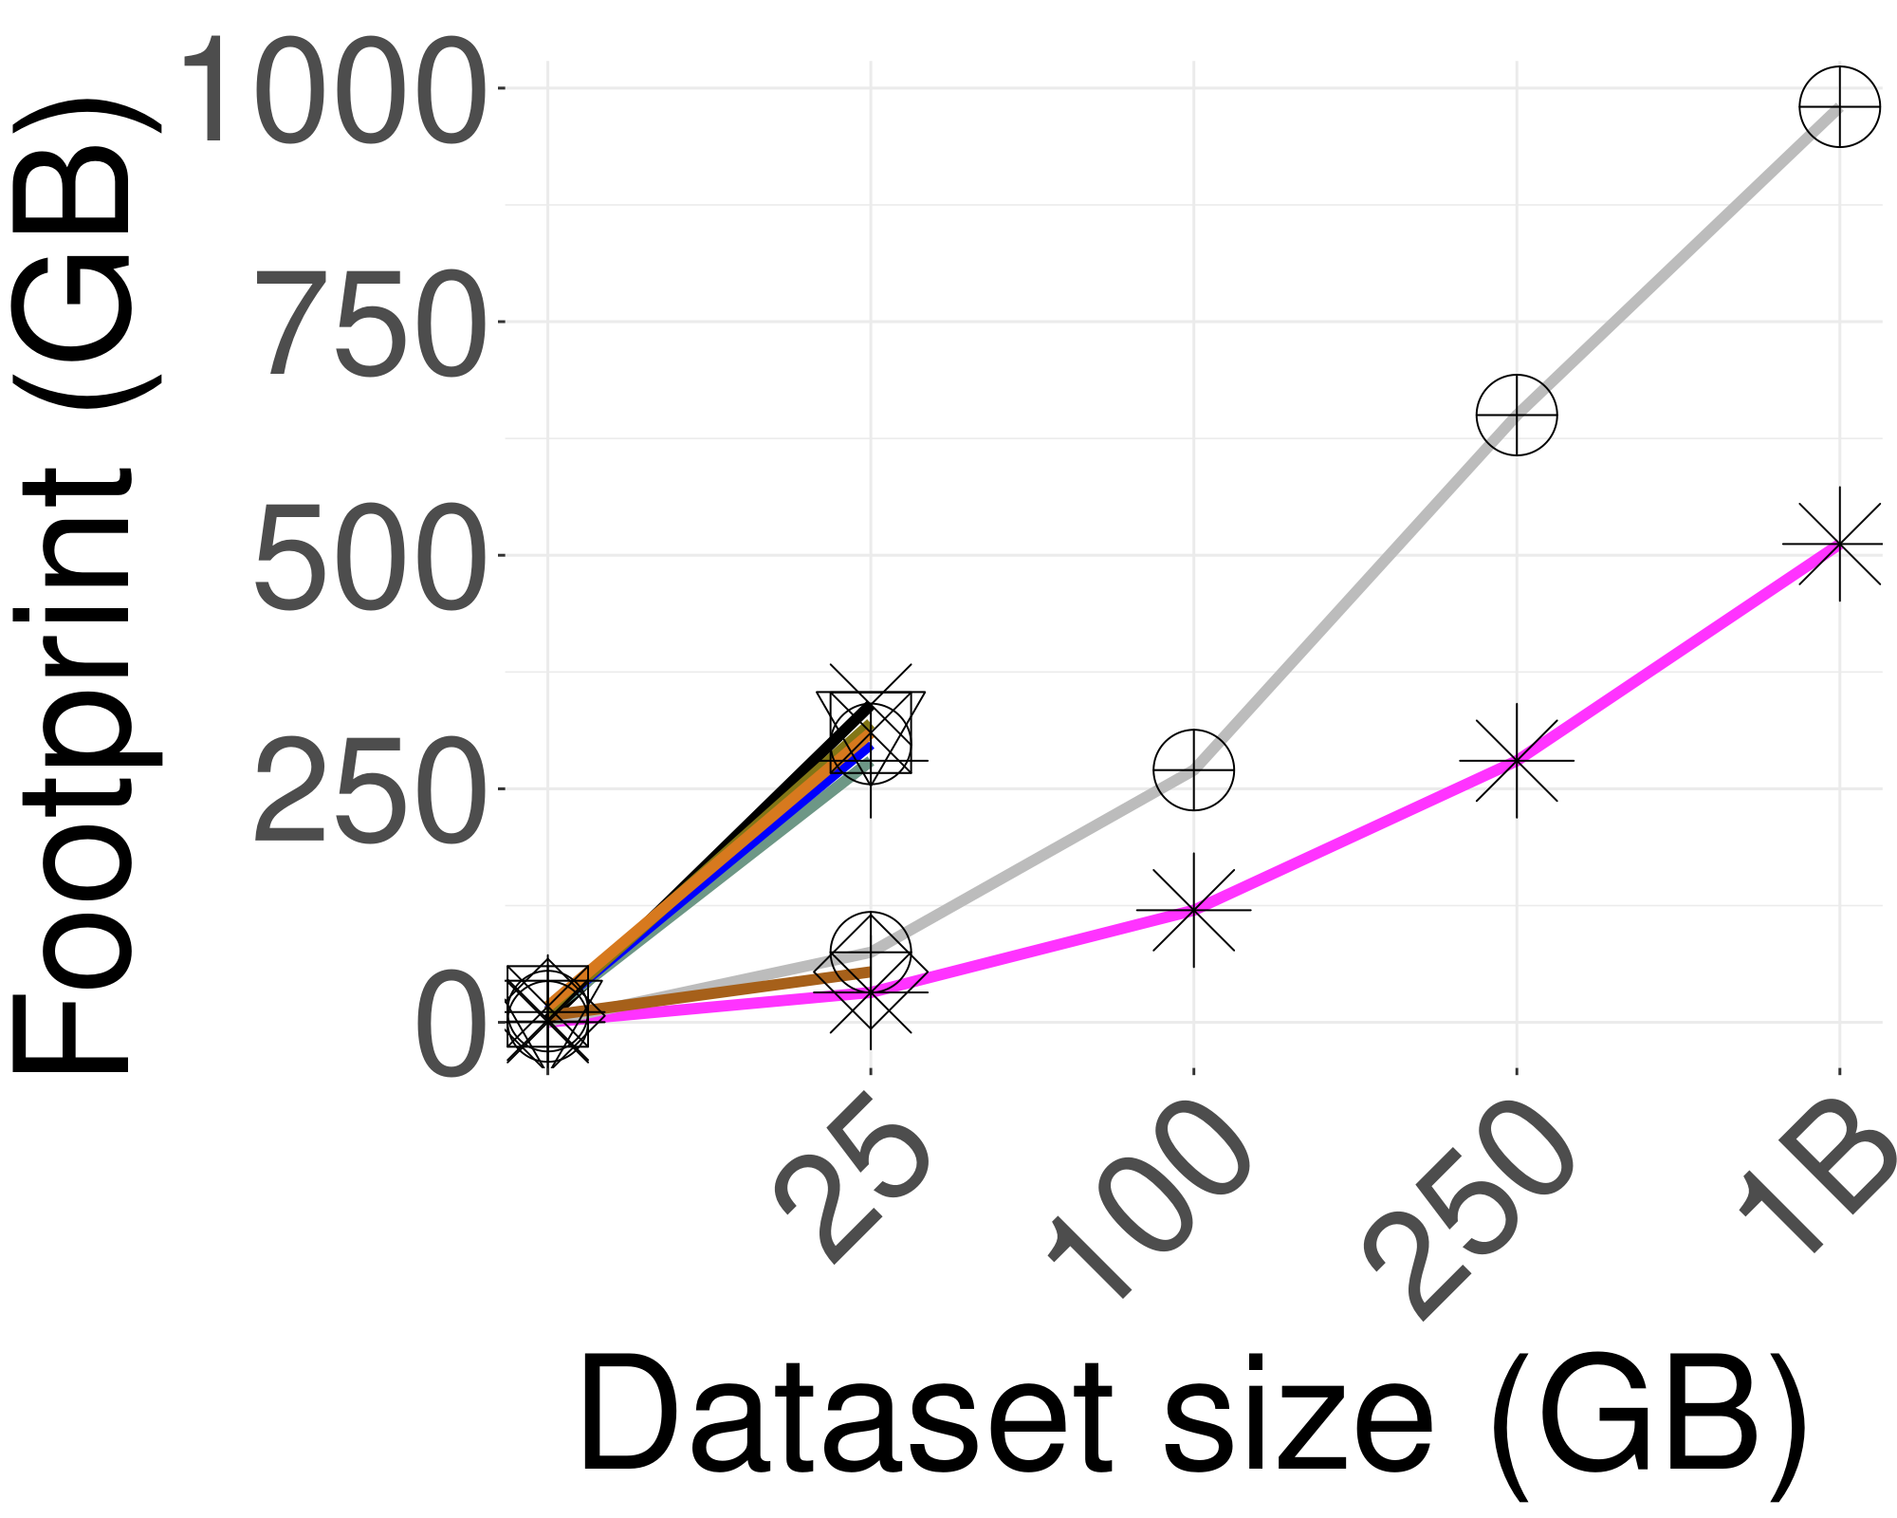
Main Results
Scalability of indexing time and memory footprint with dataset size (Deep)
Elpis builds the index up to 8x faster
than the best competitors
Using 40% less memory
Notes:
Elpis builds a more efficient lightweight index up to 8x faster than best competitors,
using 40% less memory and demanding lower memory usage during search process.

Slide 45
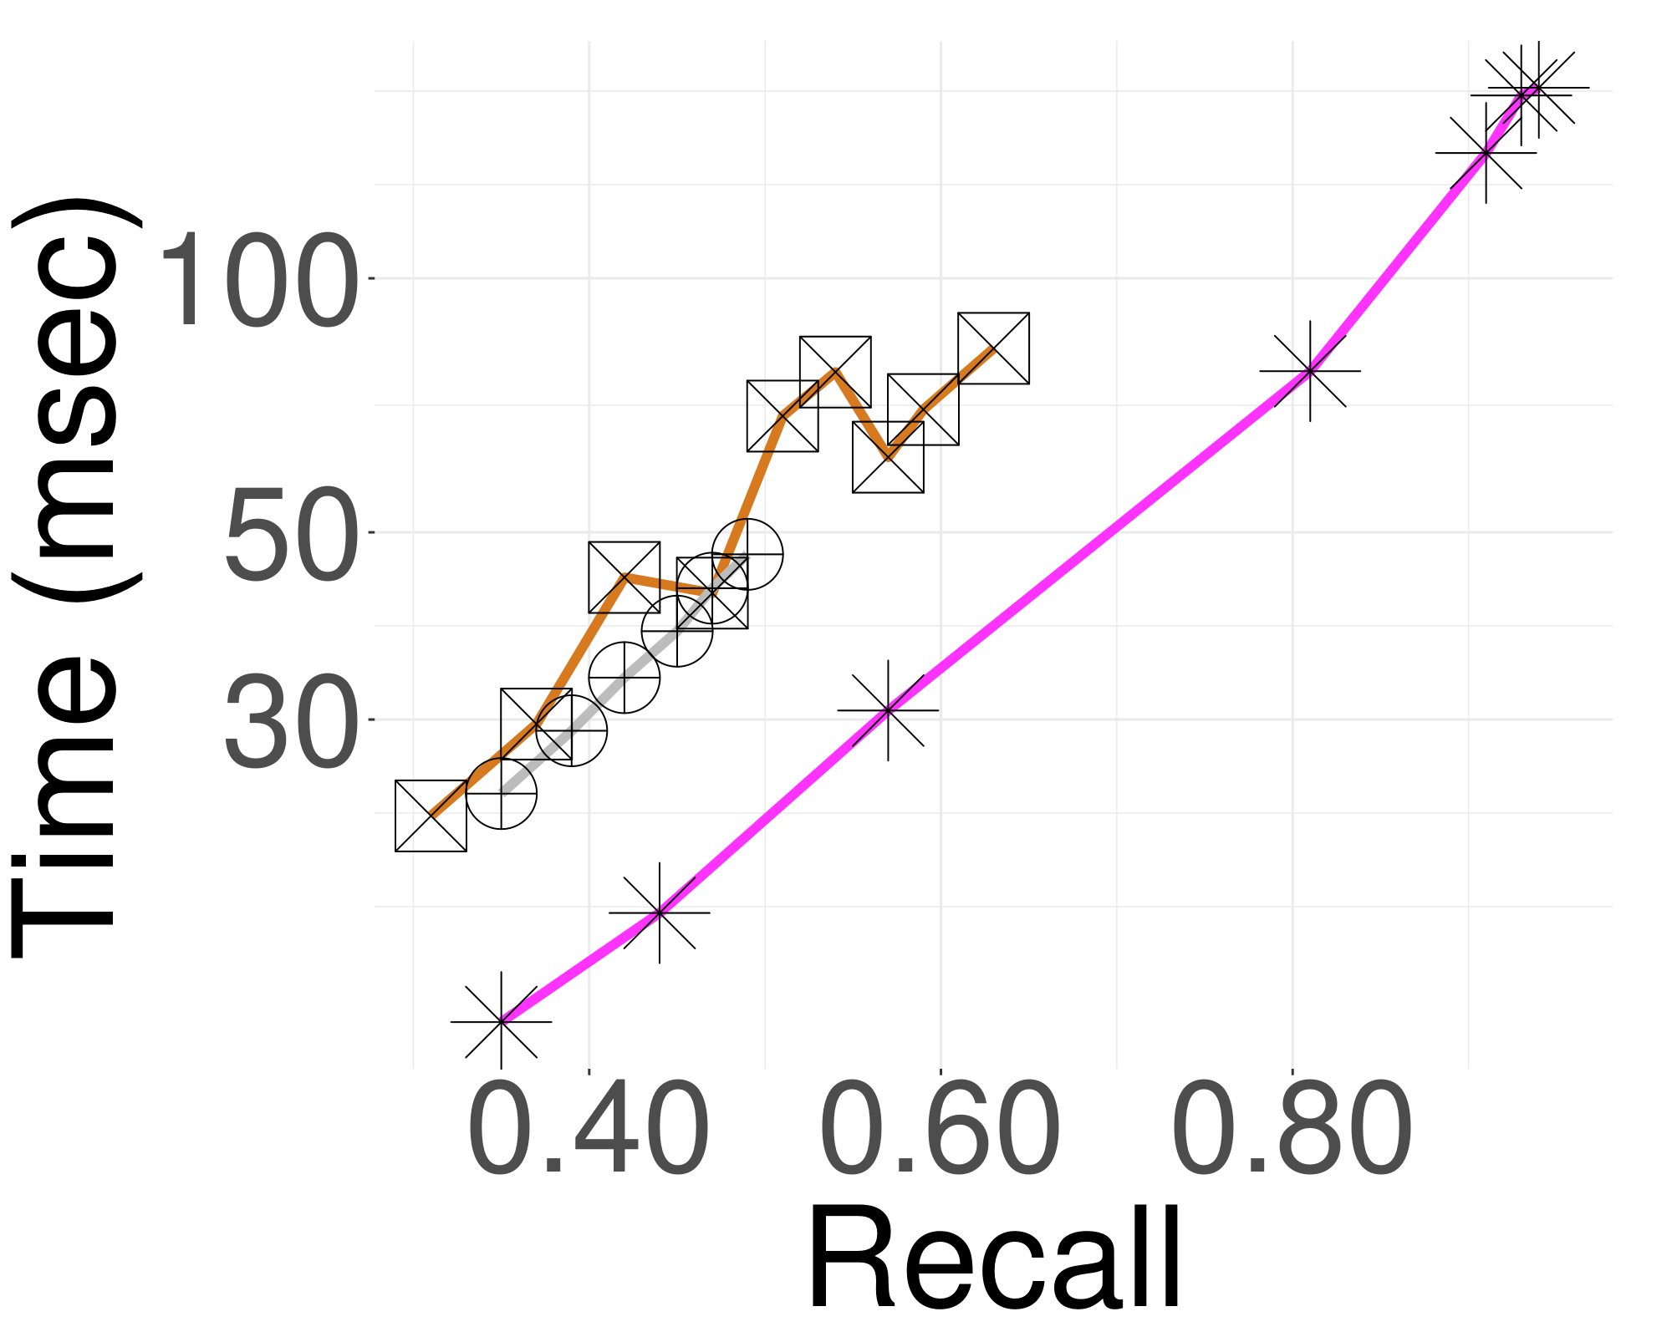
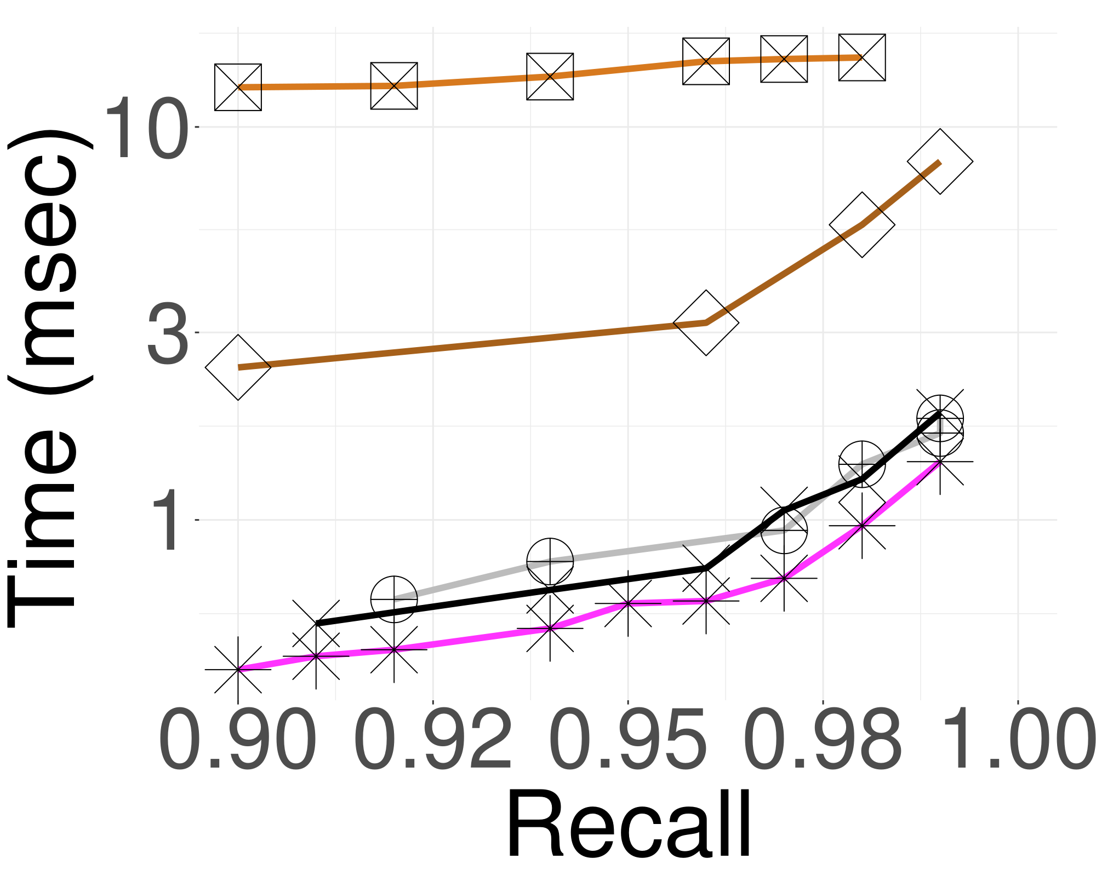
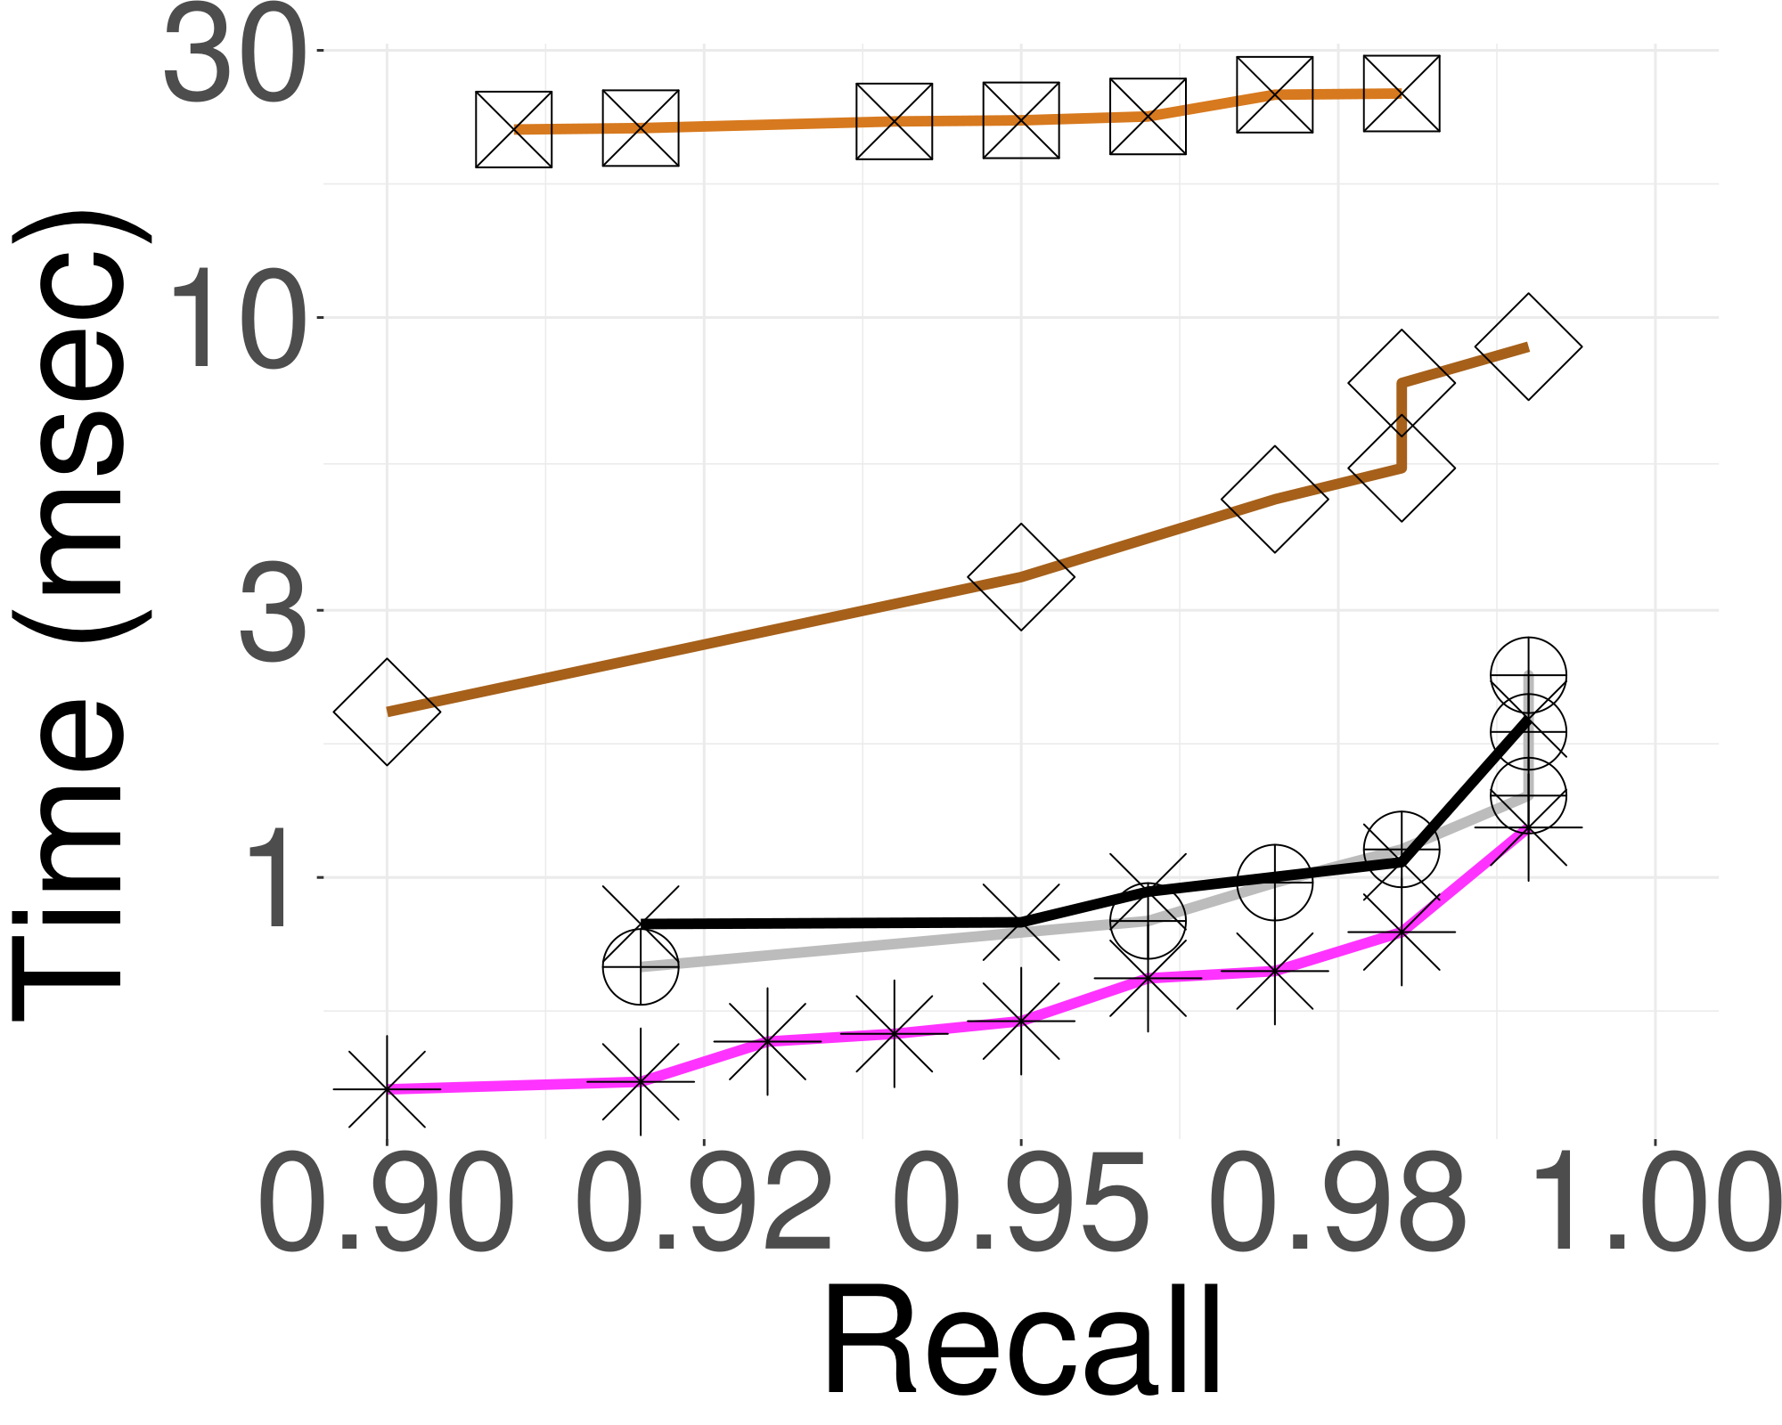
Main Results
Query Performance on 25GB datasets (Synthetic, Sift and Deep)
Elpis wins across random and real-world datasets
Synthetic
Sift
Deep
Notes:
achieves high accuracy and good performance on highly clustered random data, and real world datasets of 25gb

Slide 46
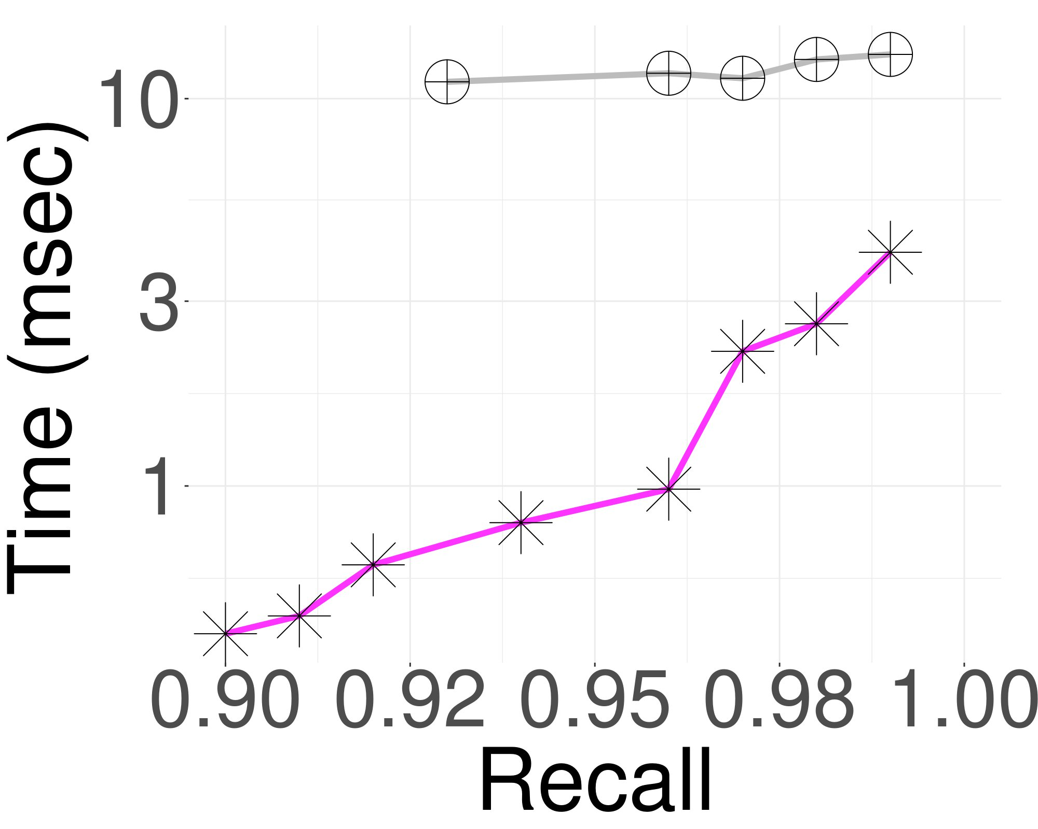
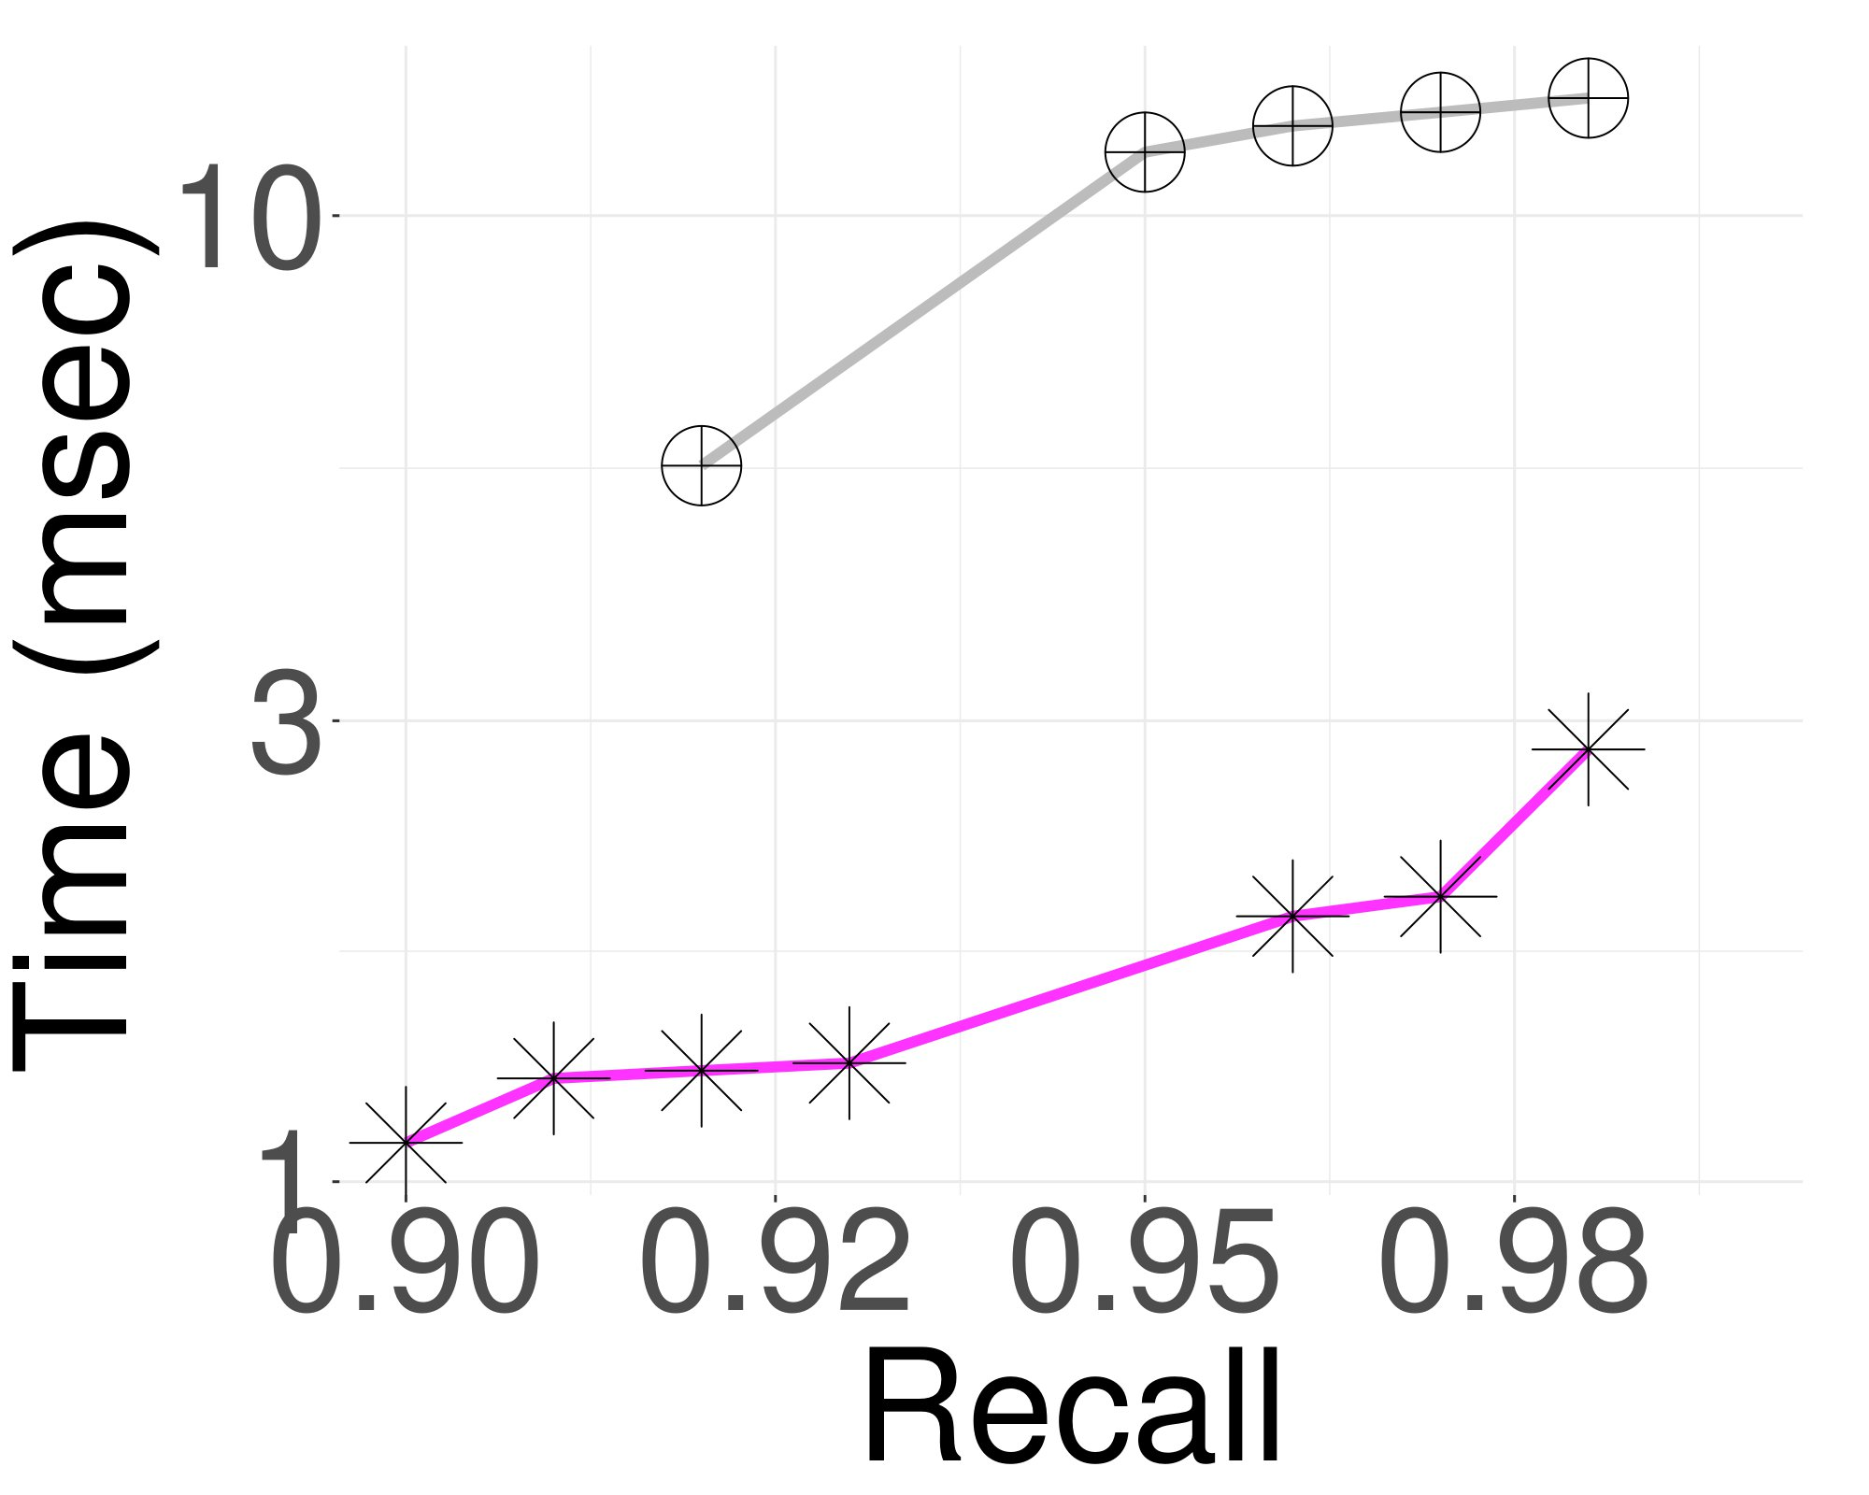
Main Results
Query Performance on 1B vectors datasets (Sift, Deep)
ELPIS delivers a 10NN query response in under 3 milliseconds for a dataset of 1 billion vectors with a high recall 0.99
Sift
Deep
Notes:
ELPIS delivers a ten nn query response in under 3 milliseconds for a dataset of 1 billion vectors, coupled with a high recall of 0.99.

Slide 47
Conclusions and Future Work
ELPIS: new solution for in-memory 𝑛𝑔-approximate similarity search over massive collections of high-dimensional vectors.
Takes advantage of the best features of both tree and graph based index to achieve superior performance for indexing and ng-approximate search.
Builds the index up to 8x faster than the best competitors, using 40% less memory.
Achieves recall of 0.99, up to 2x faster than state-of-the-art methods (on most scenarios), and answers 1-NN queries up to one order of magnitude faster.
Future directions include:
Adapt Elpis to inter-query parallel search.
Design a novel graph structure for Elpis clusters.
Incorporate learning process in building & search graph-based similarity search index.

Slide 48
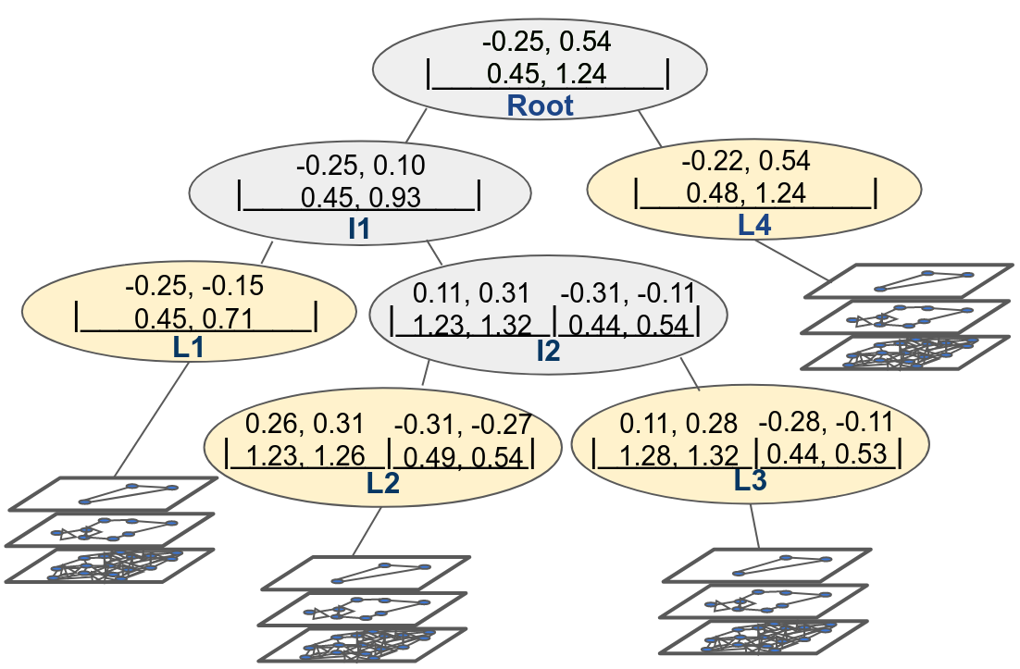
Thank you!
Elpis: Graph-Based Similarity Search for Scalable Data Science
Ilias Azizi, Karima Echihabi, Themis Palpanas
Artifacts available at: https://helios2.mi.parisdescartes.fr/~themisp/elpis
Please stop by our poster stand today(75):
Wednesday 17:30 – 19:00

